Slide 1

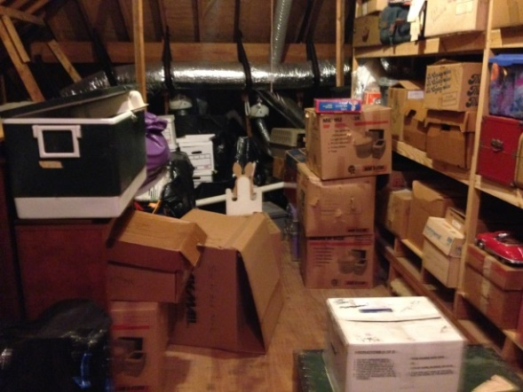
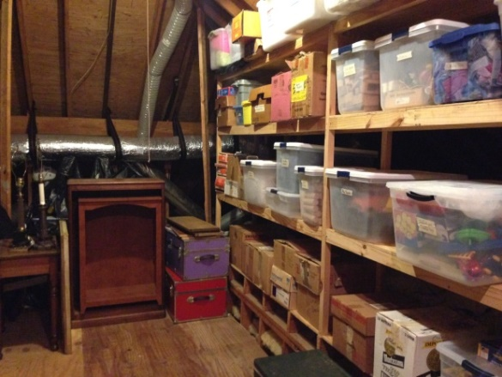
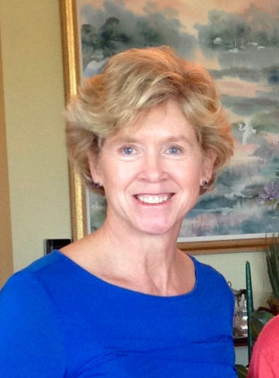
Organizing Express LLC, owned by Coleman Legerton, can assist you and your real estate client maximize the marketability of their home and minimize the stress of relocating to a new home.
Decluttering closets and storage space
Disposition of excess possessions – sale, donation, shipping, recycling, trash, etc.
Staging the home for sale
Organizing papers and files
Floor planning for new space
Packing and labeling boxes
Unpacking and organizing the new home
Arranging services such as handyman, cleaning, computer and TV hook up, storage facility, etc.
Coleman Legerton 843.209.8376
coleman@organizingexpress.com
www.organizingexpress.com

