Slide 1
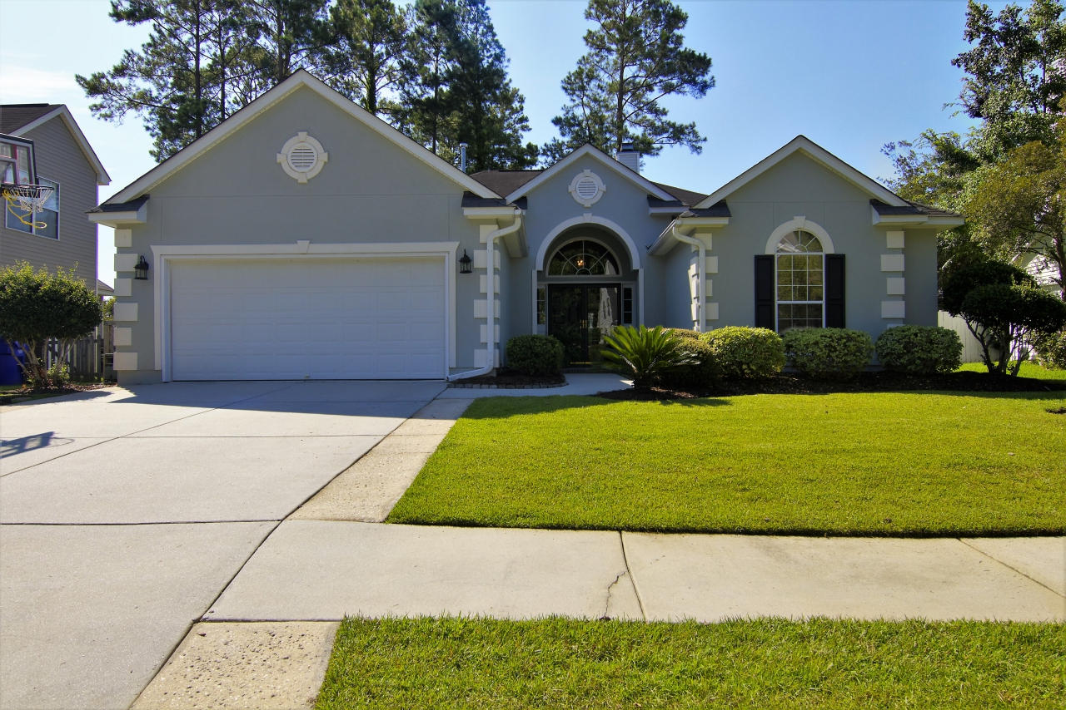
Coming Soon!
This immaculate ranch style home in Park West is just about to hit the market! Do you have a client who wants a three bedroom home with a designated office space, too? This beautiful residence in popular Park West in Mt. Pleasant will be listed this weekend. The home has hardwood floors and the kitchen is outfitted with granite counters and stainless steel appliances. If an open floor plan is desired your buyer will not be disappointed. This is the sought after Delaware floor plan! Contact Ellen O'Neil at 843-300-8530 or Ellen@EllenONeilRealty.com if you are interested to learn more.
Ellen O'Neil
Broker/Owner
Ellen O'Neil Realty
ABR, e-PRO, CNE
Charleston Realtor of Distinction
(843)300-8530
http://EllenONeilRealty.com

