Slide 1
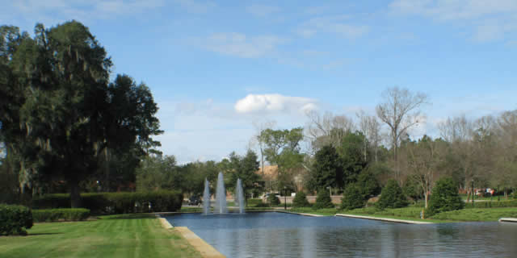
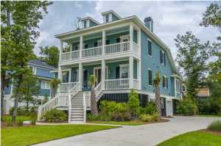
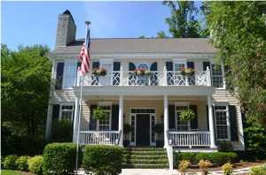
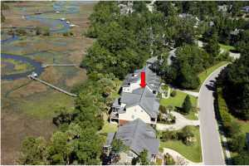
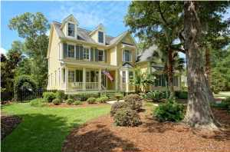
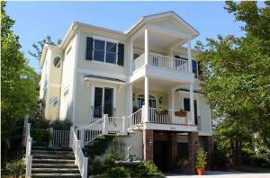
Park West Agent Open House
Thursday, February 12th from 11:00a-1:00p
Come Tour Five Luxury Homes in
Masonborough, Wheatstone, & Tennyson
Lunch Served And Drawings To Be Held at 3541 Henrietta Hartford Rd
Drawings for $100 Mastercard, gas card, and other prizes!!
You must visit each of the 5 homes to qualify for the drawings.
Please tour the homes in the following order:
1535 Capel St.
3419 Henrietta Hartford Rd.
1665 Sewee Fort Rd.
3561 Henrietta Hartford Rd.
3541 Henrietta Hartford Rd
1535 Capel Street
6 Bedrooms, 4/2 Baths, 4,991sf
MLS# 1420240
Offered at $725,000
Melodie R Smith
Carolina One Real Estate
843-408-5067 melodie.smith@carolinaone.com
3419 Henrietta Hartford Road
5 Bedrooms, 3/1 Baths, 3,704sf
MLS# 1412763
Offered at $619,900
Keith & Kim Pruitt
Carolina One Real Estate
843-345-1537
kpruitt@carolinaone.com
1665 Sewee Fort Road
5 Bedrooms, 3/1 Baths, 3,516sf
MLS# 1410429
Offered at $699,000
Keith & Kim Pruitt
Carolina One Real Estate
843-345-1537
kpruitt@carolinaone.com
3561 Henrietta Hartford Road
6 Bedrooms, 4/1 Baths, 3,845sf
MLS# 1417494
Offered at $685,000
Bill Barnhill
Keller Williams Realty
843-364-6903
bill@billbarnhill.com
3541 Henrietta Hartford Road
4 Bedrooms, 5 Baths, 4,938sf
MLS# 14032026
Offered at $849,000
Wendy Arnsdorff
Carolina One Real Estate
843-364-8619
wendy.arnsdorff@carolinaone.com

