Slide 1
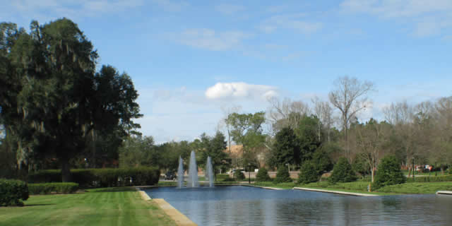
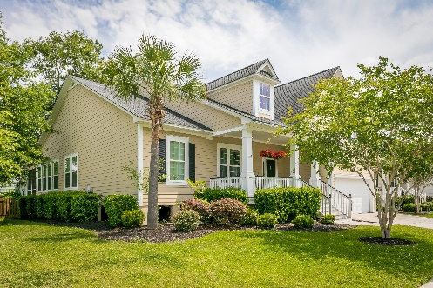
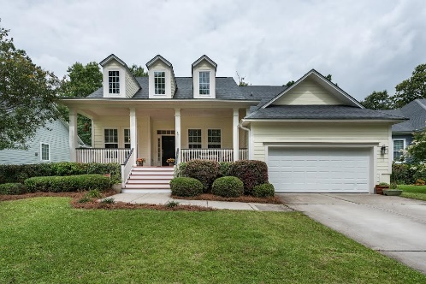
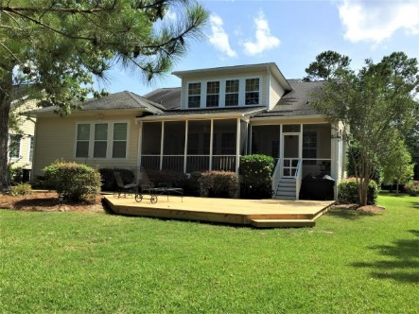
Park West Agent Open House
Thursday, July 13th
$100 Gift Card, Food, Beautiful Homes!
11:30-1:30 3429 Toomer Kiln and 1805 Two Cedar
11:30-12:45 3590 Toomer Kiln
3429 Toomer Kiln Circle
MLS# 17012822
$519,900
Cheryll Woods-Flowers
843-442-2219
cflowers@woodsflowers.com
Coldwell Banker Residential Brokerage
3590 Toomer Kiln Circle
MLS# 17017383
$485,000
Pat Broghamer
843-725-8095
patbroghamer@realtor.com
RE/MAX Alliance
1805 Two Cedar Way
MLS# 17015397
$528,950
Kristin Rush
843-885-8816
kristin@chsdreamhomes.com
ERA Wilder Realty

