Slide 1
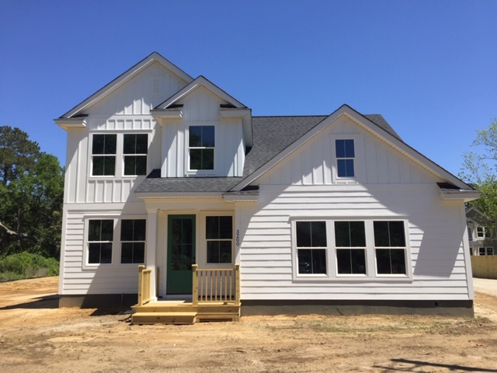
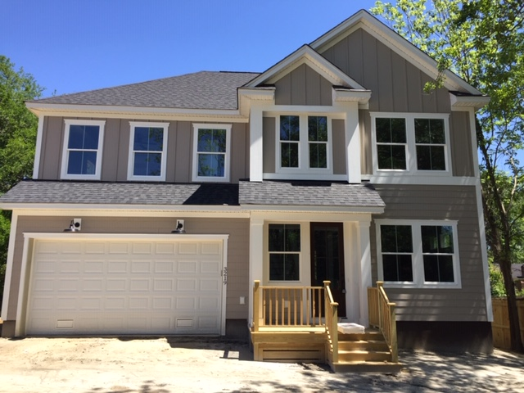



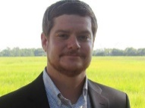
Zoom Virtual Open House Wednesday at 2:30
3200 Pecan Orchard Way
MLS# 20005075
$375,000
3 Bedrooms :: 2½ Baths :: 1,750 sf
Pecan Orchard is a brand-new subdivision in West Ashley
Send your clients (they will be protected!) or tag along yourself!
RSVP to Jon@CharlestonRealEstateGroup.com!
3219 Pecan Orchard Way
MLS# 20005033
$395,000
4 Bedrooms :: 2½ Baths :: 2,081 sf
Eric Draper
(843) 442-7118
eric.draper@gmail.com
Jon Moore
(843) 732-3365
jon@charlestonrealestategroup.com
www.charlestonrealestategroup.com
Charleston Real Estate Group | 443 Folly Road | Charleston, SC 29412

