Slide 1
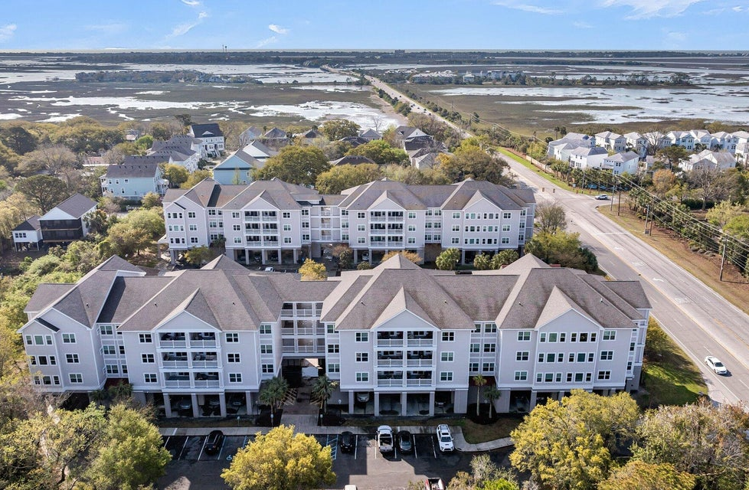
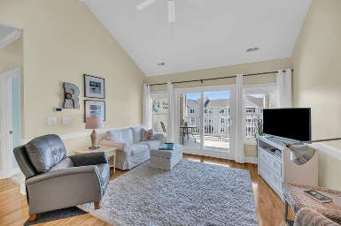
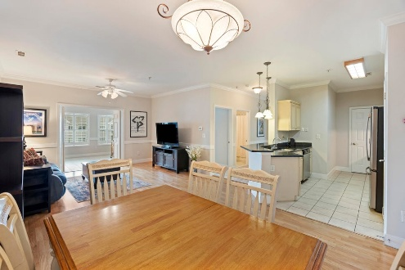
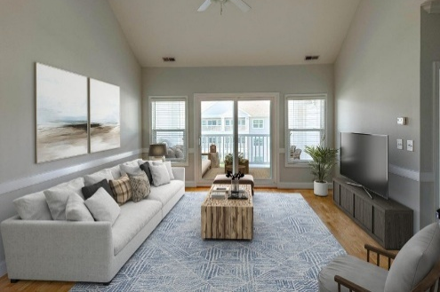

1984 Folly Road A306 MLS# 25009162 | $410,000
PELICAN POINTE - BROKER EVENT
Thursday, May 22nd | 10:30am-12:30pm | Progressive Light Lunch Will Be Served
2 Bedrooms | 2 Baths | 1133 sqft | Elevator to 3rd Floor
1984 Folly Road A307 MLS# 25011226 | $419,000
1984 Folly Road B304 MLS# 24015235 | $415,000
Steve Kaul 843-817-5547
skaul@carolinaone.com
Ginny Williams 843-442-3791
ginny.williams@carolinaone.com
Deborah Wooten 843-442-6876
dashman@carolinaone.com
Carolina One Real Estate
195 W Coleman Blvd
Mt Pleasant, SC 29464-3495

