Slide 1
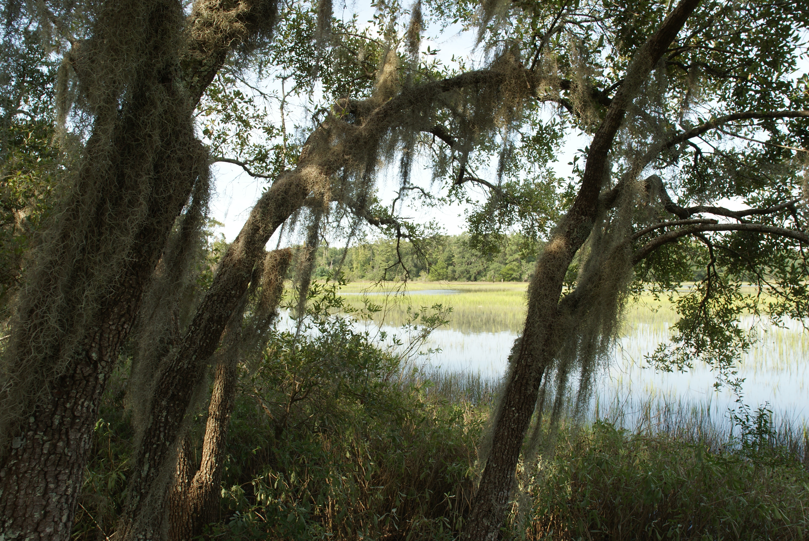
Looking for pocket listing in Groves, Cooper Estates, Snee Farm or
Wakendaw Lakes for $500k or less.
Please call me if you have a Pocket Listing!
Buyer needs something right away
Kristen Whitehead
843-670-1671
kwhitehead@kwchs.com

