Slide 1
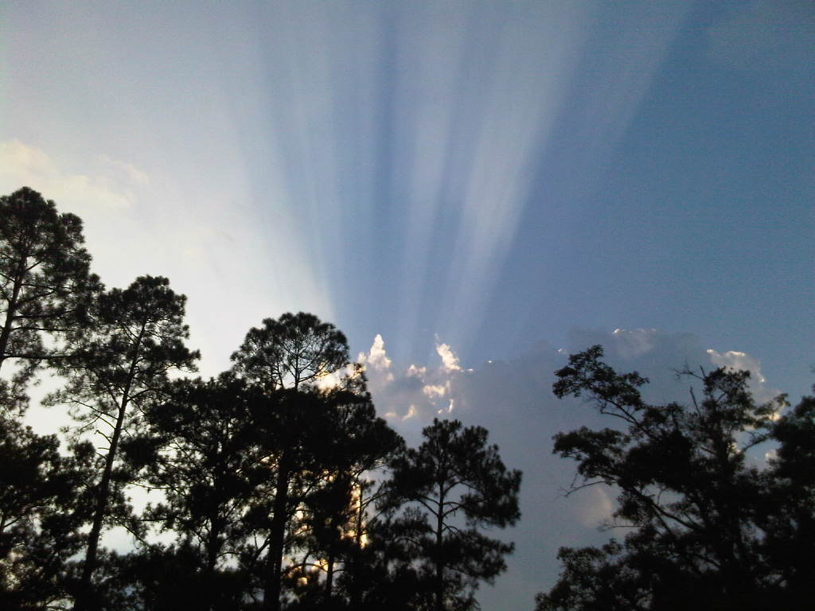
Anyone have a listing coming on the market soon in 29464? We are looking for homes not currently in MLS! At least 2000sf, prefer 4 bedroom but can do 3, prefer larger lot with fenced backyard, priced between $400k-550k. Please call me if you have any upcoming listings!
Buyer needs a house in South Mt Pleasant ASAP!
Kristen Whitehead
843-670-1671
kwhitehead@kwchs.com

