Slide 1
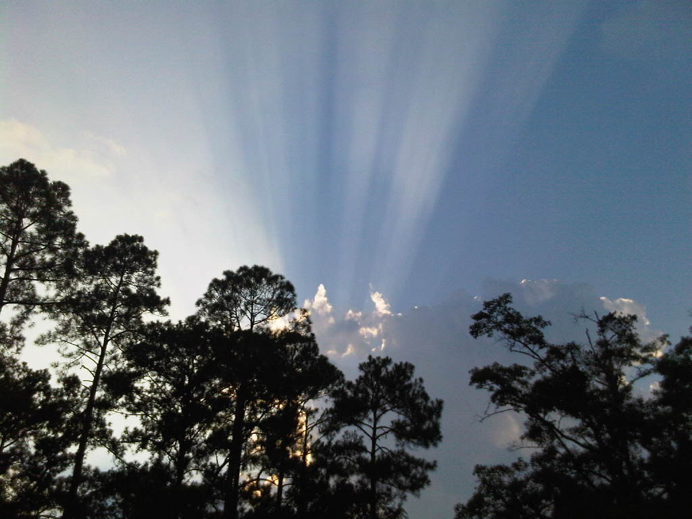
Anyone have a listing coming on the market soon in 29464? We are looking for homes not currently in MLS! Priced below $350,000. Please call or email me if you have any upcoming listings!
Buyer needs a house in South Mt Pleasant ASAP!
Kristen Whitehead
843-670-1671
kwhitehead@kwchs.com

