Slide 1
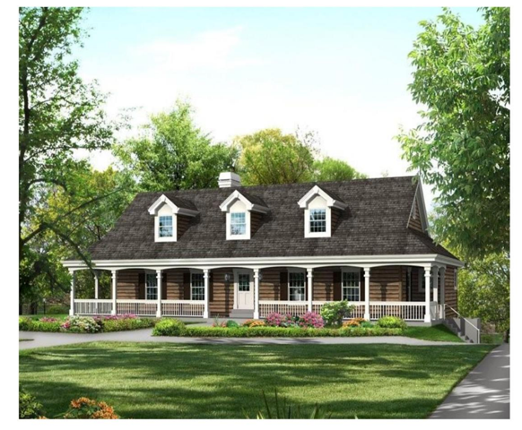
I HAVE A QUALIFIED BUYER IN SEARCH OF 2+ACRES OF VACANT LAND IN RIDGEVILLE/ SUMMERVILLE AREA. PREFER BEECH HILL OR SAND HILL ELEMENTARY SCHOOL. WOODED LOT W. MINIMAL WETLANDS & THEY PREFER NO HOA.
Buyer Needs Some Land In Summerville/Ridgeville!
OR, A 4BR HOME ON 2+/- ACRES. SAME REQUIREMENTS AS MENTIONED ABOVE
Erin Quinn Hanhauser
Direct: 843-416-8256
Cell: 843-743-8204
erin@radekopf.com
Radekopf And Associates
1205 Two Island Court Ste. 201
Mt. Pleasant, SC 29466-7406
http://www.radekopf.com

