Slide 1
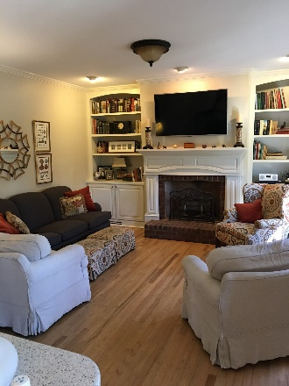
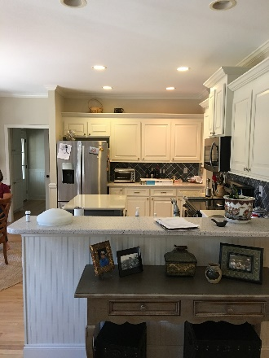
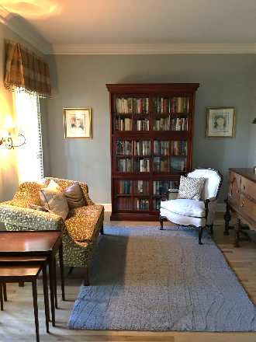
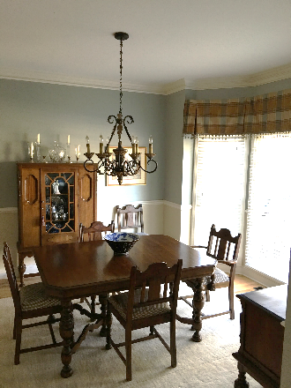
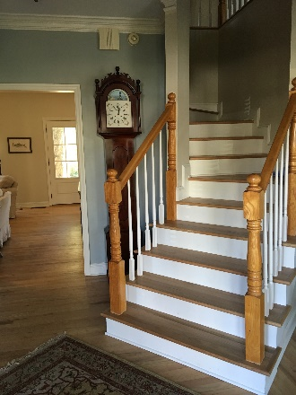
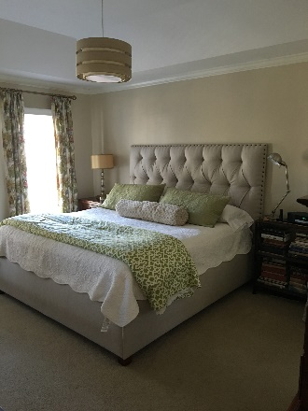
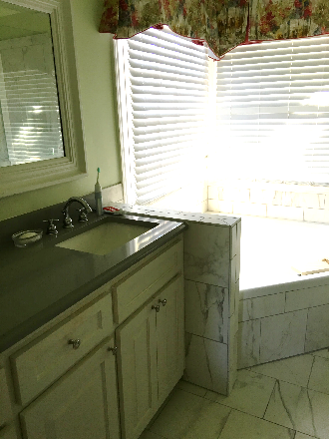
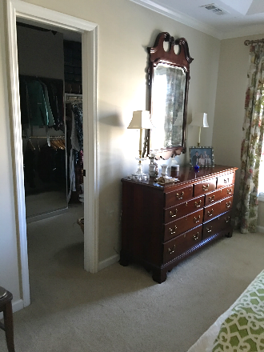
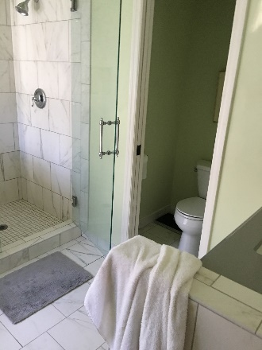
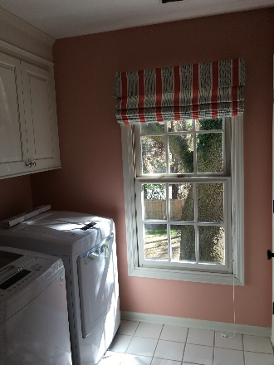
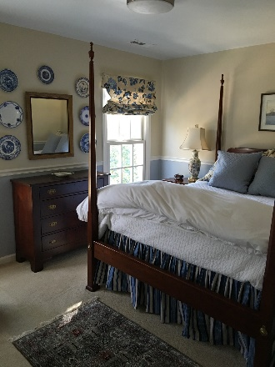
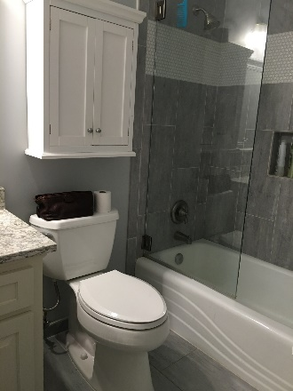
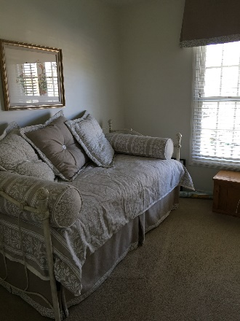
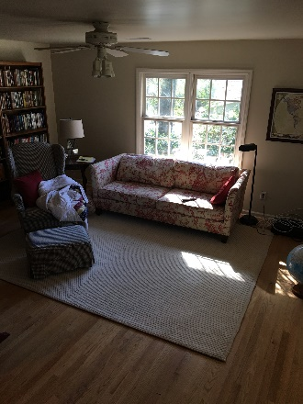


2244 Ashley Crossing Dr #123
Charleston, SC 29414
MLS# 16028555
$143,000
1 Bedrooms | 1 Baths | 896 sf
Pocket Listing on Middleburg in Longpoint in Mt. Pleasant
Beautiful, custom-built, one owner,
3 bedroom / 2 ½ bathroom, full finished FROG (with 2 closets), new quartz counters in kitchen, stainless appliances, "bangin' bathrooms", oak floors, custom window treatments, clean carpet in bedrooms, beautifully maintained paint selections, large fenced back yard, 2 car garage, grand oak trees, horseshoe pit and lots more.
If you'd like to take a look before it goes on market, please give me a call.
Liz Harris Nimmich
(843) 442-9044
liz.nimmich@agentownedrealty.com
www.LizHarrisNimmich.com
AgentOwned Preferred Group | 1400-G Palm Blvd | Isle Of Palms, SC 29451

