Slide 1
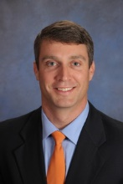
- Immediate Need - Deep Water in Northern Mt. Pleasant
- Immediate Need -
Deep Water in Northern Mt. Pleasant
Dear Charleston Agents:
We have a well qualified buyer ready to act ASAP looking for:
Northern Mt. Pleasant (ideally Park West, Dunes West, Rivertowne)
Deep water with dock, dock permit, or permit attainable
Existing home, proposed construction, or open to a vacant buildable lot
Budget is Up to $1.2M
If you have an upcoming listing, pocket listing, or know someone that has a house that fits our buyer’s criteria and is not on the MLS please contact Scott Baskin at 843-619-7355 or Scott@ScottBaskinTeam.com.
Scott Baskin
(843) 619-7355 M | (843) 414-7167 O scott.r.baskin@gmail.com | www.scottbaskin.com
RE/MAX Advanced Realty
1350-B Ashley River Road
Charleston, SC 29403

