Slide 1
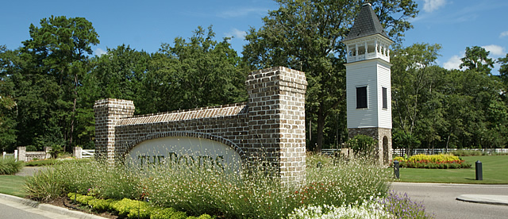
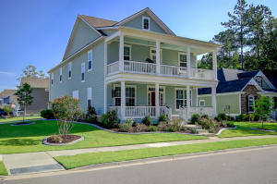
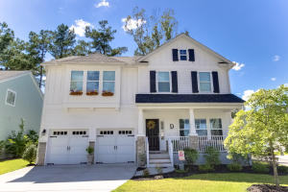
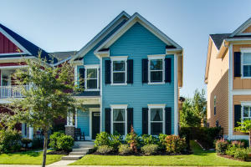
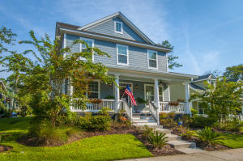
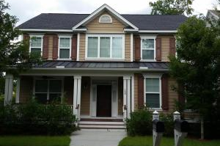
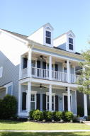
Open House at The Ponds Thursday, Nov 10, from 11:30-1:00 ~ Lunch will be served ~ Several gift cards will be given out for touring the homes
212 Ribbon Road
MLS# 16018228 | $375,000
Suzy M Torres
843-425-9451
storres@carolinaone.com
Carolina One Real Estate
107 Tortoise Street
MLS# 16020176 | $339,500
Donald Russell
843-478-5015
donald@chucktownhomes.com
ChuckTown Homes, LLC
193 Lotz Drive
MLS# 16024324 | $289,900
Laurie A Loparo
843-442-1290
laurieloparo@gmail.com
Golden Bear Realty, LLC
104 Red Bay Lane
MLS# 16024282 | $359,900
Lindsey Grulke Martin
843-697-4870
lindsey.grulke@carolinaone.com
Carolina One Real Estate
150 Donning Drive
MLS# 16022540 | $370,000
Susan Woodworth Kraber
843-779-9655
susankraber1@gmail.com
ERA Wilder Realty
221 Lotz Drive
MLS# 16012274 | $259,900
Jody Glance
843-817-6817
jodysellsthelowcountry@gmail.com
BHHS Southern Coast Real Estate

