Slide 1
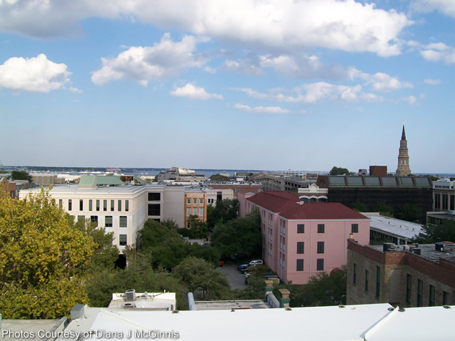
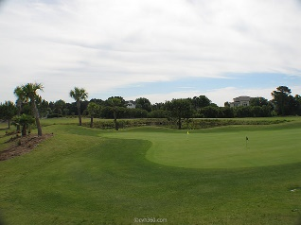
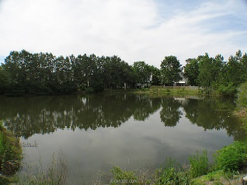
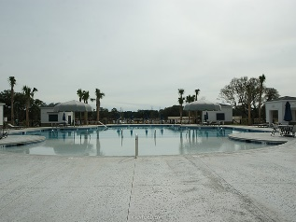

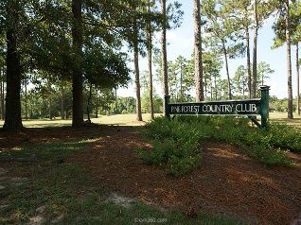

I have a qualified Buyer Looking for 3-4 Bedroom Home. Please call me if you have a seller who is willing to rent-to-own!
Listing Not Selling? Buyer will Rent to Own…
Robin Phillips
(843) 214-8451
Robin@ThePhillipsRealtyGroup.com

