Slide 1
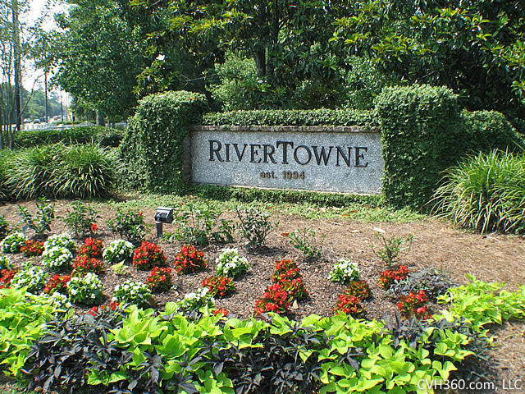
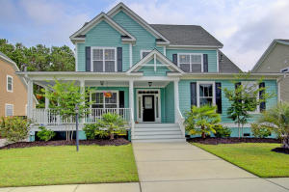
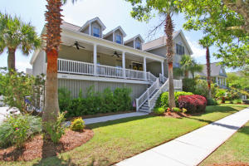
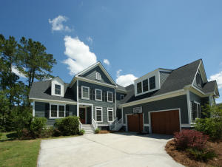
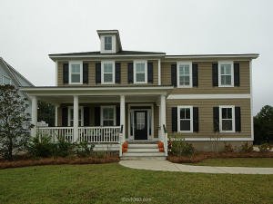
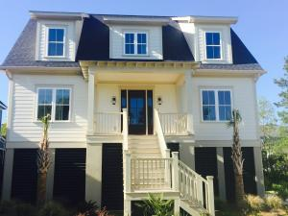
RiverTowne Progressive Open House
Tuesday, June 7th from 11:45-1:45
Leave your business card at each location to be entered in a $100 cash drawing
2610 River Bluff Lane Molly Ramey Carolina One
Serving Charcuterie Platter
2041 Laurel Springs Leesa Northrup Carolina One
Serving Chicken Salad
2604 Alderly Lane Jennifer Nipper-Crockett AgentOwned Preferred Group
Serving Mexican Salad
2014 Shields Lane David Seay Seay Development
Serving Non-Alcoholic Drinks
2608 Alderly Lane Phil Rose Twin Rivers Capital LLC
Serving Dessert

