Slide 1
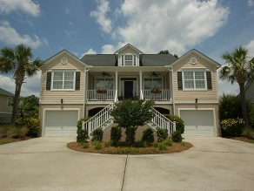
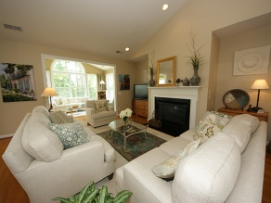
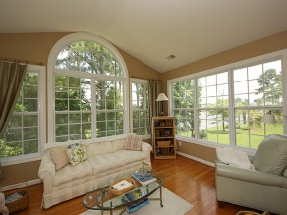
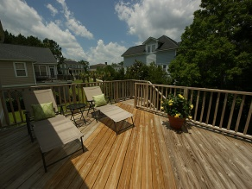
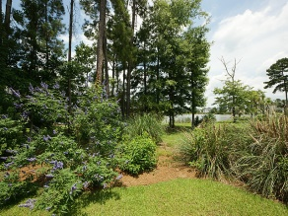
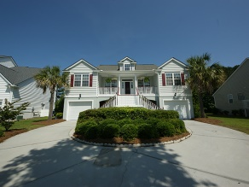
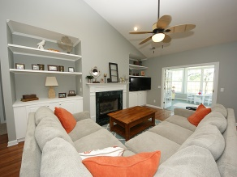
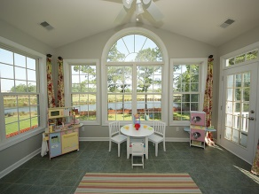
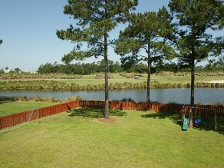
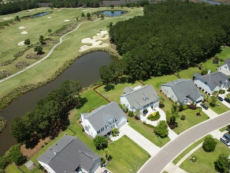
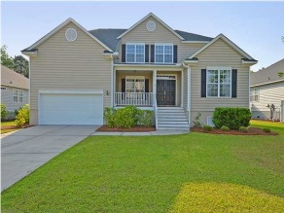
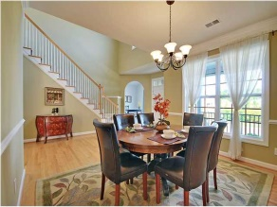
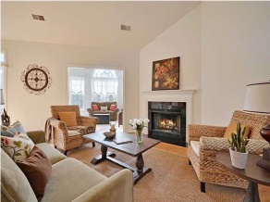
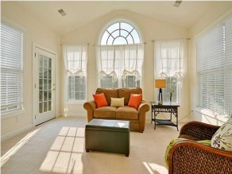
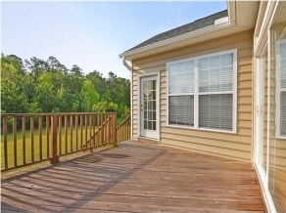
RiverTowne Country Club Open Houses July 10th, 11-1
2767 Carolina Isle - MLS# 1415865 - $445,000
Listed by Holly Culp // AgentOwned Realty
(843) 270-2586 // holly.culp@agentowned.com
1621 Oakhurst Dr - MLS# 1414085 - $479,000
Listed by Jeff Popper // Carolina One Real Estate
(843) 460-7168 // jpopper@carolinaone.com
1437 Oakhurst Dr - MLS# 1411360 - $435,000
Listed by Chris Facello // Carolina One Real Estate
(843) 412-7274 // cfacello@carolinaone.com
Lunch will be provided. Visit all three homes and leave your card to be entered in the gas card drawing.
For more information, please contact one of the agents listed above.

