Slide 1
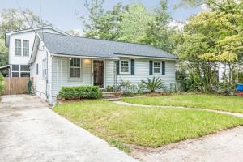
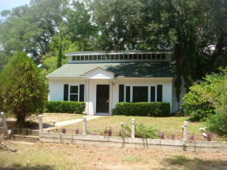
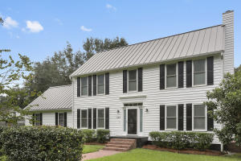
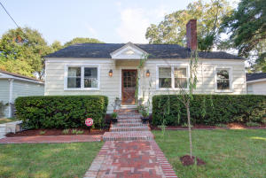
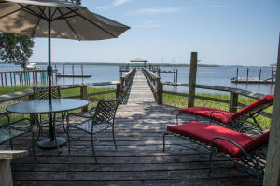
RIVERLAND TERRACE AGENT OPEN HOUSES
Thursday, Oct. 20, 2016
11:30-1
$379,999
2125 Edisto Avenue
Charleston, SC 29412
Active / 16020315
Kay Kennerty
Chicken Salad
$310,000
2170 Welch Avenue
Charleston, SC 29412
Active / 16020819
Price Reduced
David Wertan
$509,000
2211 Seroy Street
Charleston, SC 29412
Active / 16023662
Donna Urban
$539,000
2044 Medway Road
Charleston, SC 29412
Active / 16026153
Ed Hunnicutt
$2,995,000
105 Riverland Drive
Charleston, SC 29412
Active/16004781
Helen Geer

