Slide 1
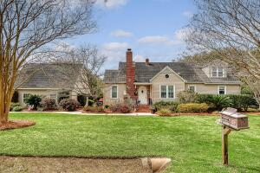

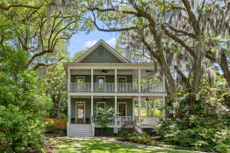

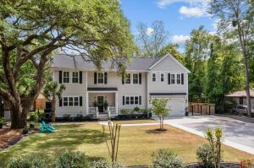

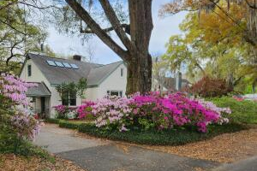

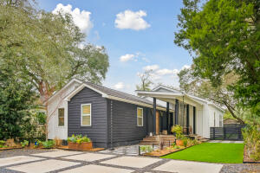
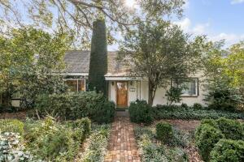

Riverland Terrace Open Houses
Saturday, May 17th from 1:00 - 3:00
95 Plymouth Ave
MLS# 25005963
$1,398,000
Hosted by Edie Schaller
The Boulevard Company
2187 Saint James Dr
MLS# 25012166
$1,950,000
Hosted by Harrison Gilchrist
William Means Real Estate
2159 Parkway Dr
MLS# 25011350
$1,850,000
Hosted by Wendy Arnsdorff
Carolina One Real Estate
2169 Westrivers Rd
MLS# 25012771
$1,668,000
Hosted by Walter Barton
RE/MAX Southern Shores
2166 Welch Ave
MLS# 25005275
$1,000,000
Hosted by Beverly Burris
William Means Real Estate
2137 Wappoo Dr (Open 12-2)
MLS# 25010794
$1,199,000
Hosted by Marissa Castello
Maison Real Estate

