Slide 1
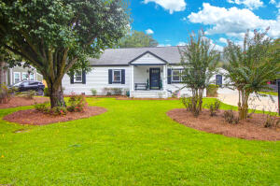
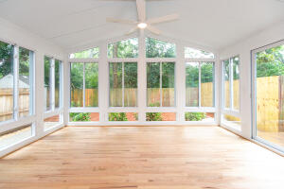

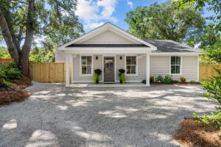
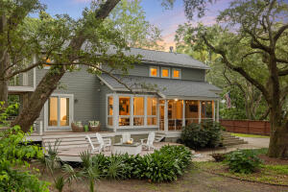

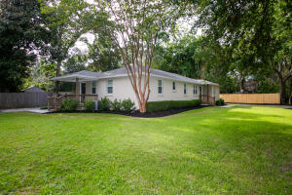
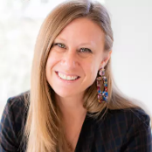
RIVERLAND TERRACE - FOUR AGENT OPEN HOUSES
Thursday, 09/ 25 from Noon-1:30 | Refreshments Served
2078 Saint James Drive
MLS# 25024859 | $1,200,000
Alicia Mendicino
843-729-1408 | aliciam@carolinaone.com
Carolina One Real Estate
2136 Parkway Drive
MLS# 25022089 | $635,000
Marion Jackson
843-442-4404 | mj@charlestonpropertybrokers.com
Charleston Property Brokers
2161 Welch Avenue
MLS# 25018716 | $919,000
Taylor Tillman
843-437-6369 | taylor.tillman@agentownedrealty.com
AgentOwned Realty Preferred Group
2217 Ramsay Street
MLS# 25021189 | $1,325,000
Harrison Gilchrist
843-209-4658 | harrison@williammeans.com
William Means Real Estate, LLC
2136 Parkway Drive A&B
MLS# 25022102 | $1,270,000
Marion Jackson
843-442-4404 | mj@charlestonpropertybrokers.com
Charleston Property Brokers

