Slide 1

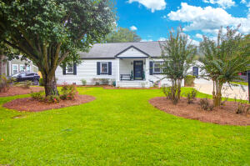
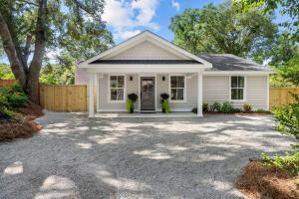
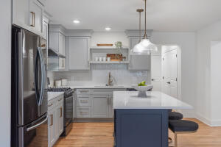
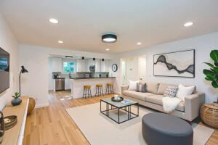
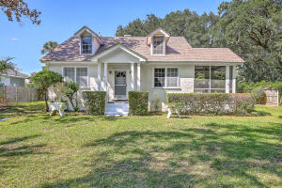
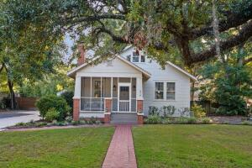
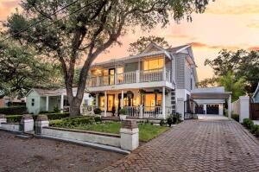
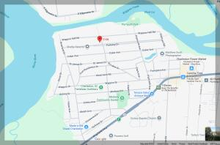
RIVERLAND TERRACE - MULTIPLE AGENT OPEN HOUSES
THURSDAY, October 16th from NOON - 1:30 PM | Refreshments Provided!
2136 Parkway Drive
MLS# 25022089 | $635,000
Marion Jackson
843-442-4404 | mj@charlestonpropertybrokers.com
Charleston Property Brokers
2078 Saint James Drive
MLS# 25024859 | $1,200,000
Alicia Mendicino
843-729-1408 | aliciam@carolinaone.com
Carolina One Real Estate
2161 Welch Avenue
MLS# 25018716 | $919,000
Taylor Tillman
843-437-6369 | taylor.tillman@agentownedrealty.com
AgentOwned Realty Preferred Group
125 Plymouth Avenue
MLS# 25026767 | $918,000
Stephanie Howard
843-224-5912 | stephanie@stephanie-howard.com
Elaine Brabham and Associates
2137 St Lukes Drive
MLS# 25022088 | $635,000
Marion Jackson
843-442-4404 | mj@charlestonpropertybrokers.com
Charleston Property Brokers
2028 Coker Avenue
MLS# 25024705 | $1,050,000
Lindsey Johnson
919-616-8687 | lindsey@ludifygroup.com
Real Broker, LLC
216 Woodland Shores Road
MLS# 25026960 | $1,290,000
Sandy Infinger-Bennett
843-670-4828 | sandy.infinger@gmail.com
The Boulevard Company
2142 Golfview Drive
MLS# 25016150 | $1,425,000
Amy Byrne
843-509-0818 | amy.byrne@bovenderteam.com
Compass Carolinas, LLC
2136 Parkway Drive A &B
MLS# 25022102 | $1,270,000
Marion Jackson
843-442-4404 | mj@charlestonpropertybrokers.com
Charleston Property Brokers

