Slide 1


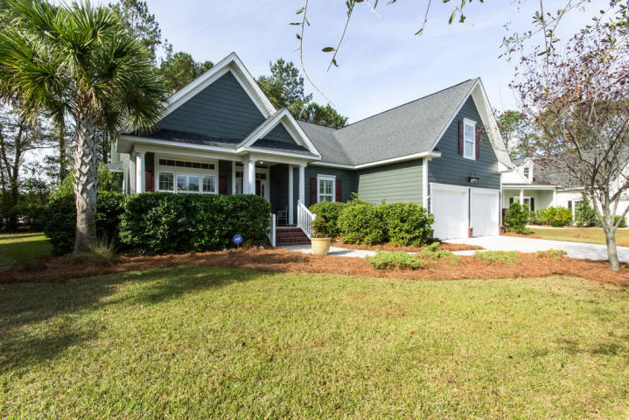
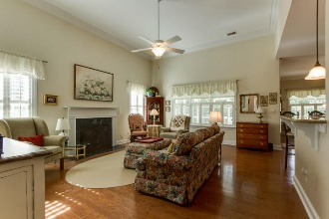
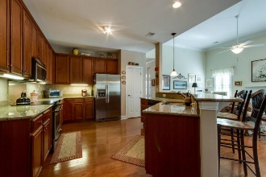
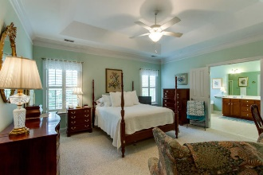
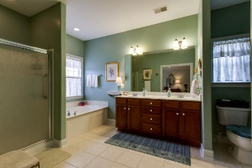
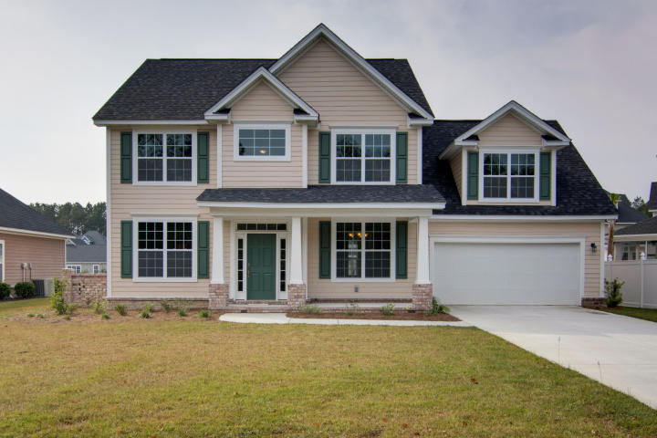
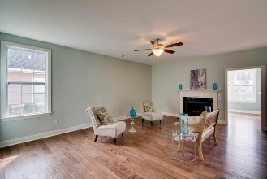
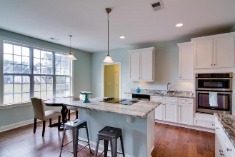
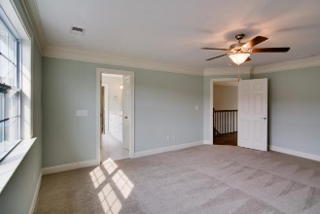
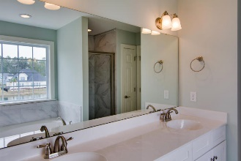
Tuesday, November 29th from 11:30-1
River Reach Pointe
Broker Open Houses
Snacks served - $50.00 gift card drawing if visit both home.
1185 Rivers Reach Drive
MLS# 16027525
$459,900
1013 Jervey Point Road
MLS# 16029662
$ 474,900
Lynn Barber
(843) 991-4186
lynn.barber@goldenbearrealty.com
Jim Heslep
(843) 343-7188
jim.heslep@goldenbearrealty.com
Golden Bear Realty | 654 Coleman Blvd, Suite 100 | Mt Pleasant , SC 29464
| Office (855) 352-9088 | Fax (561) 721-3311

