Slide 1



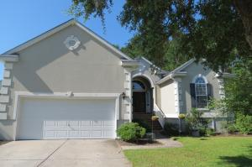
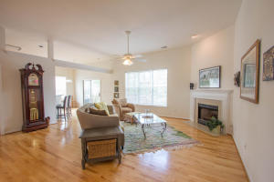
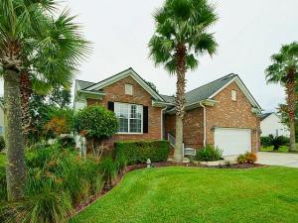
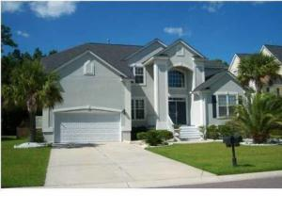
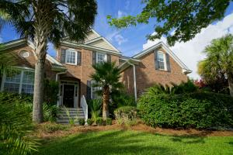
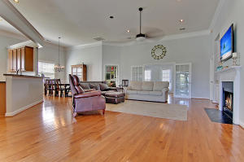
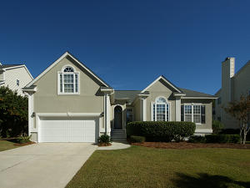
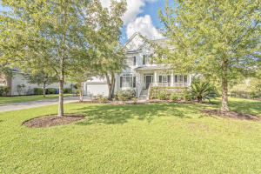
Enjoy touring beautiful homes in Rivertowne Country Club
Tuesday, December 13th, from 12-2
Refreshments and a chance to win $150 CASH!*
1924 Palmetto Isle Drive
MLS# 16017861 | $399,900
Zelda Bryant
843-330-7507
zeldabryant@gmail.com
Bryant Real Estate Group
1836 Palmetto Isle Drive
MLS# 16025509 | $349,000
Bambi Magraw
843-224-3628
bambi@charlestondwellings.com
Keller Williams Realty
1805 Great Hope Drive
MLS# 16026090 | $409,900
Dianne Broom
843-343-6207
dbroom@carolinaone.com
Carolina One Real Estate
1613 Oakhurst Drive
MLS# 16025117 | $500,000
Elizabeth Shirley
843-276-2970
lizshirleyrealestate@gmail.com
BHHS Carolina Sun Real Estate
1545 Oakhurst Drive
MLS# 16021452 | $445,000
Kristen Whitehead
843-670-1671
kwhitehead@kwchs.com
Keller Williams Realty
2799 Olympia Fields Lane
MLS# 16025659 | $429,500
Brian Kline
843-437-1487
bkline@carolinaone.com
Carolina One Real Estate
1497 Oakhurst Drive
MLS# 16030052 | $449,990
Jeff Popper
843-460-7168
jpopper@carolinaone.com
Carolina One Real Estate
1498 Oakhurst Drive
MLS# 16029278 | $499,900
Chip Walsh
843-822-4663
chipwalsh@gmail.com
The Boulevard Company
*Must get initials at all 6 properties to be eligible to win; double your chances by bringing a buyer with you (on your honor!)!

