Slide 1



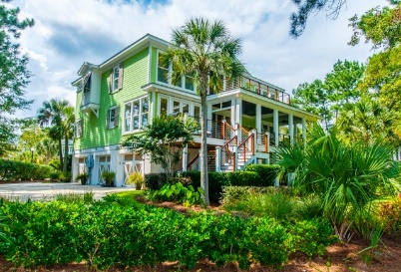
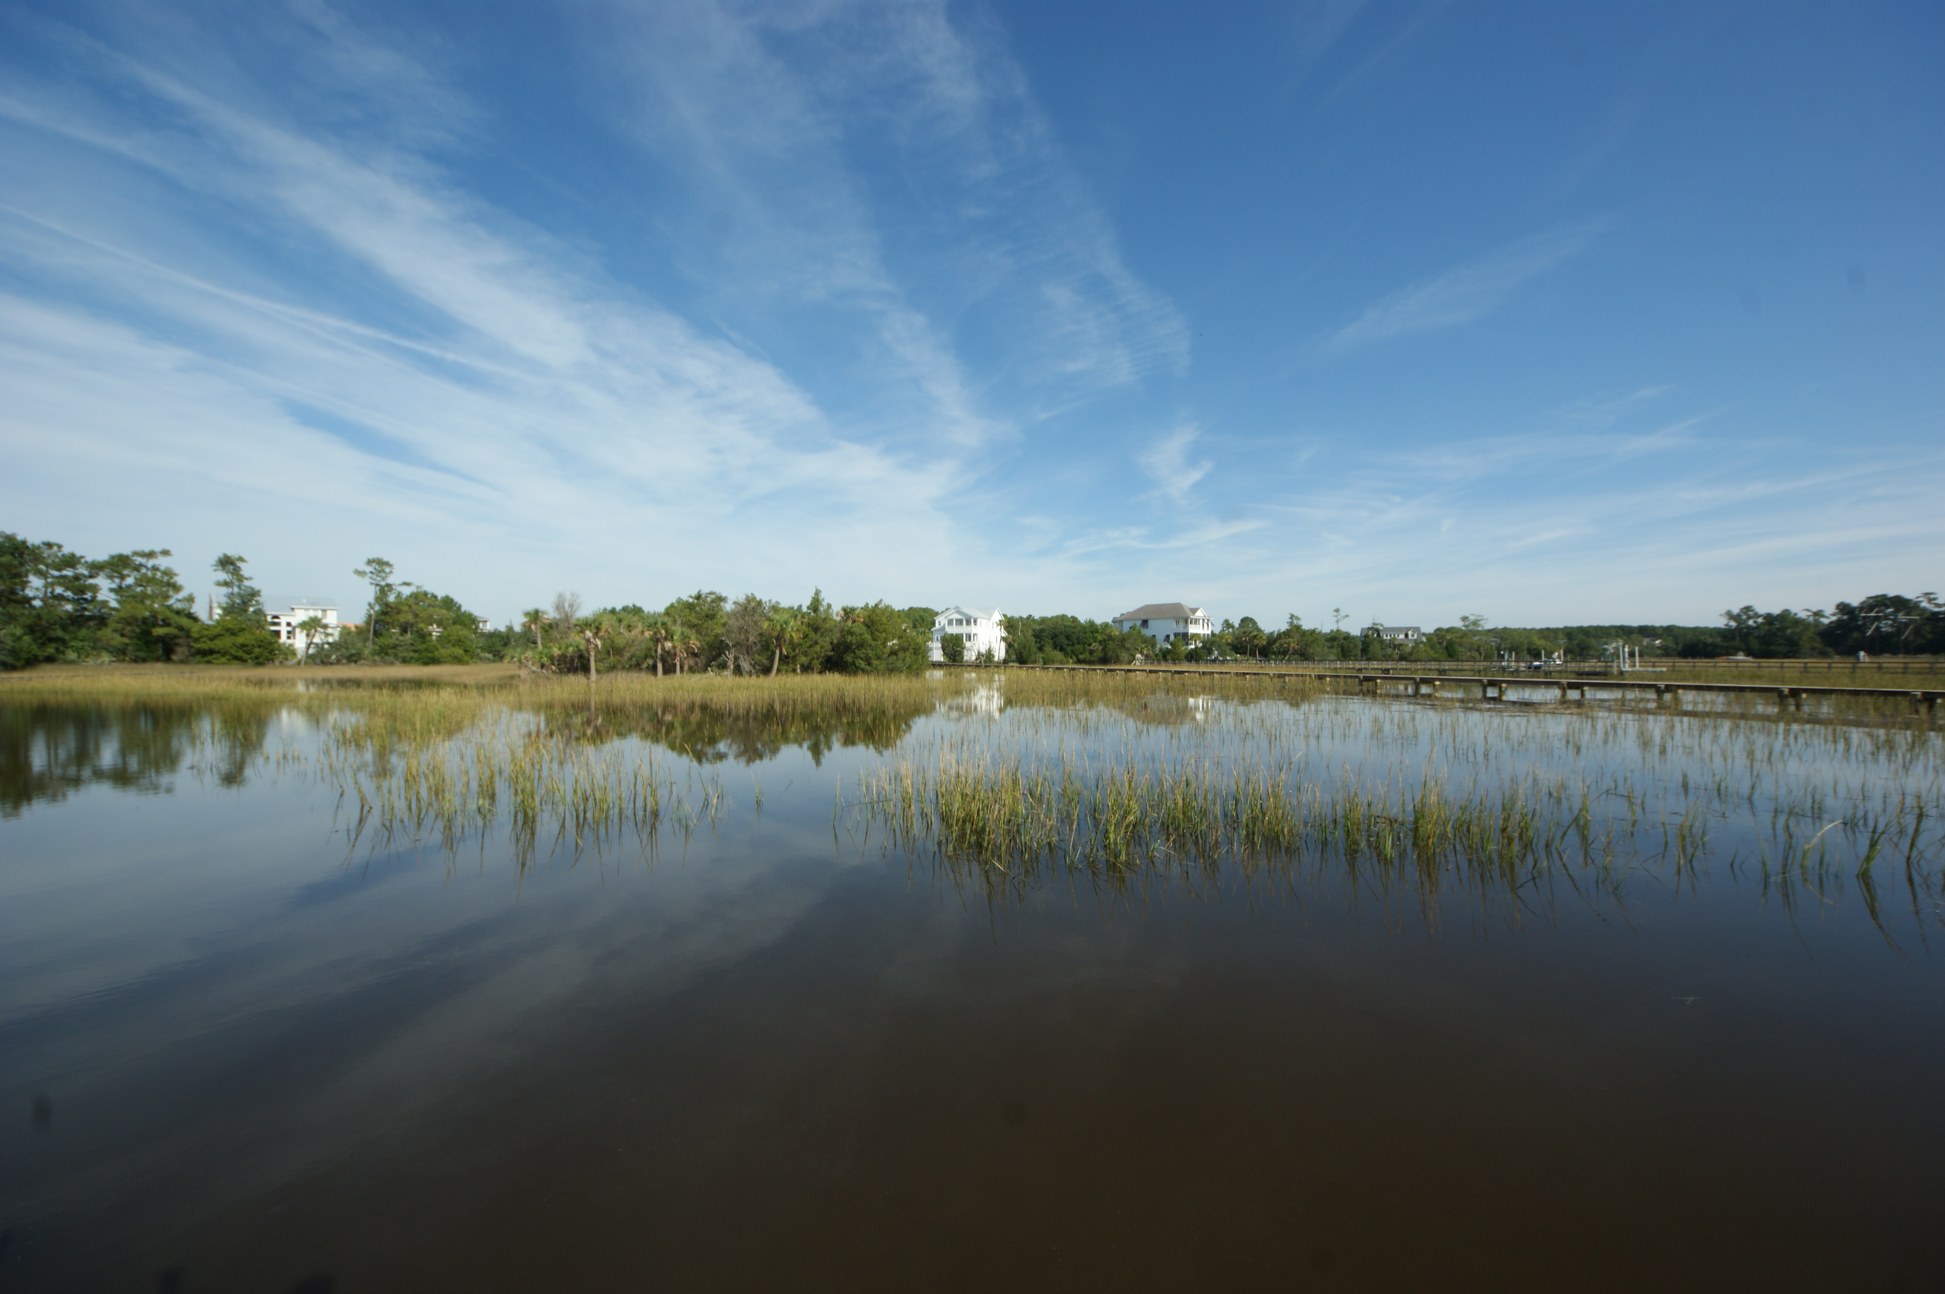
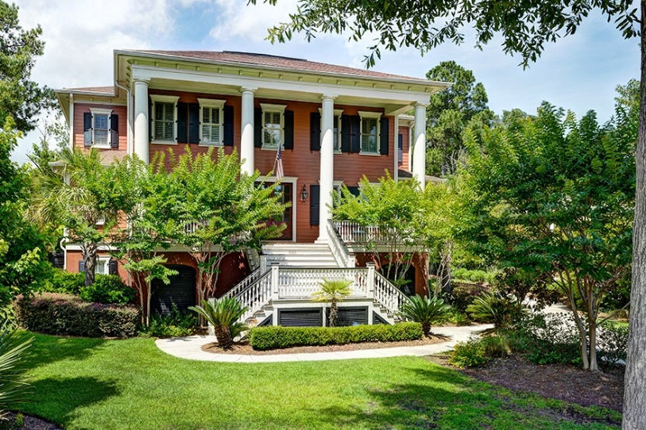
Santa wants to put some extra Christmas jingle in your pocket and all you have to do is come visit. Three great Rivertowne Country Club homes, all distinctive and gorgeous. See all 3 to be eligible to win. Special goodies too!
Thursday December 17th from 11a-1p
2625 Kiln Creek Circle
The Point @ Rivertowne Country Club
Designer Dream Home
5 bedrooms 3.5 baths
Golf course, lake and marsh views
$1,110,000
Debra Kerr and Alicia Mendicino
Carolina One Real Estate
1921 N. Creek Drive
The Point @ Rivertowne Country Club
Elegant waterfront masterpiece
4 bedrooms 4 baths
Tidal Creek with shared dock
$859,900
Leigh Brandenburg
Agent Owned Realty
1525 Rivertowne Country Club Drive
Rivertowne Country Club
Stunning Golf Course Home
5 bedrooms 4.5 baths
$899,000
Kathy Sweet
Carolina One Real Estate

