Slide 1


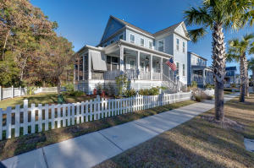
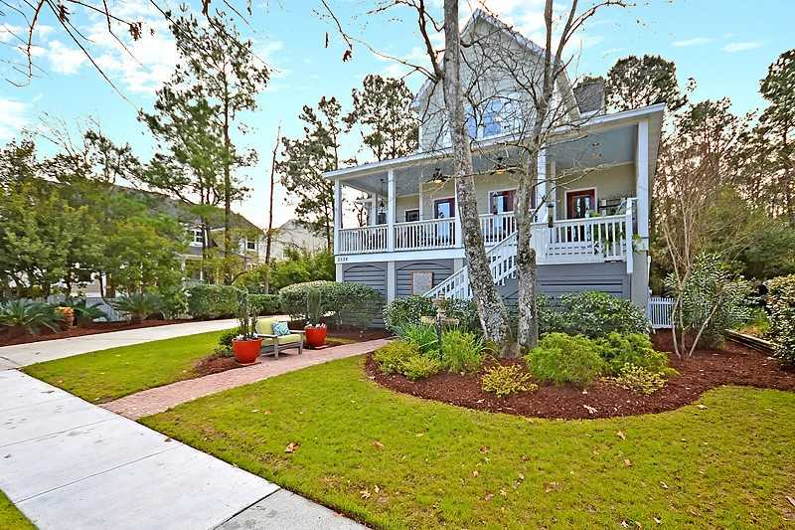
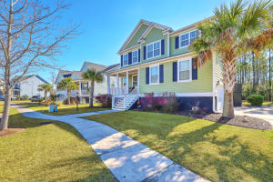
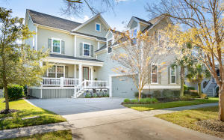

Rivertowne Progressive Agent Open Houses
11am - 1pm this Friday, February 8th
There will be a drawing for a $50 Town Center gift card
Just in time for Valentines Day!
Appetizers
Sandwiches / Wraps
This Photo by Unknown Author is licensed under CC BY
2761 Rivertowne Parkway
MLS# 18033116 | $539,900
Listed by
Elizabeth Shirley (843) 276-2970
Suzanne Conway (843) 814-6778
BHHS Carolina Sun Real Estate
2536 Willbrook Lane
Not in MLS | $499,000
Listed by
Chari Karinchak (843) 810-8287
Yvette Grist (843) 312-0696
Coldwell Banker Residential
This Photo by Unknown Author is licensed under CC BY-NC
This Photo by Unknown Author is licensed under CC BY-SA-NC
Veggie, Fruit & Cheese Tray
Fresh Pralines
2105 Sandy Point Lane
MLS# 19002869 | $629,995
Listed by
Debby Olney (843) 532-7014
Maggie Curtis (843) 693-8207
Coldwell Banker Residential Brokerage
2627 River Bluff Lane
MLS# 18032411 | $655,000
Listed by
Ashley Yarborough
(704) 649-2034
The Boulevard Company

