Slide 1
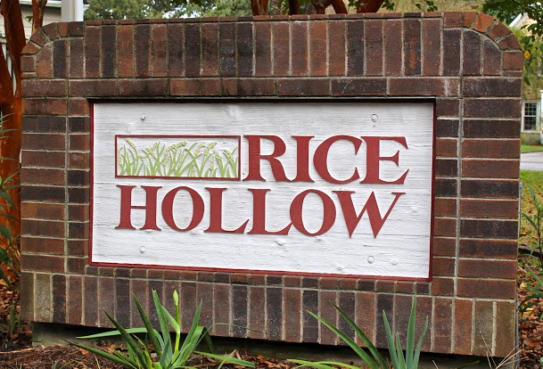
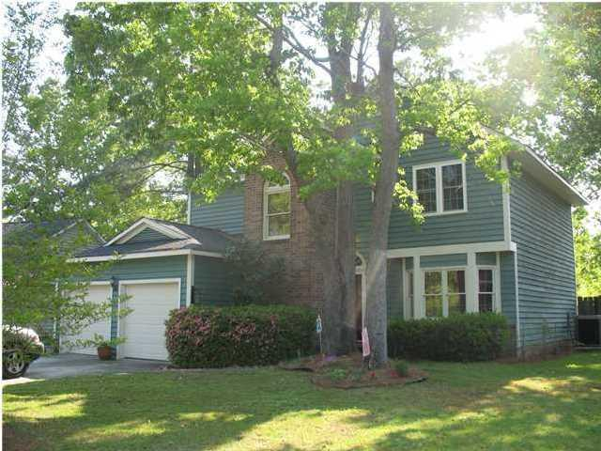
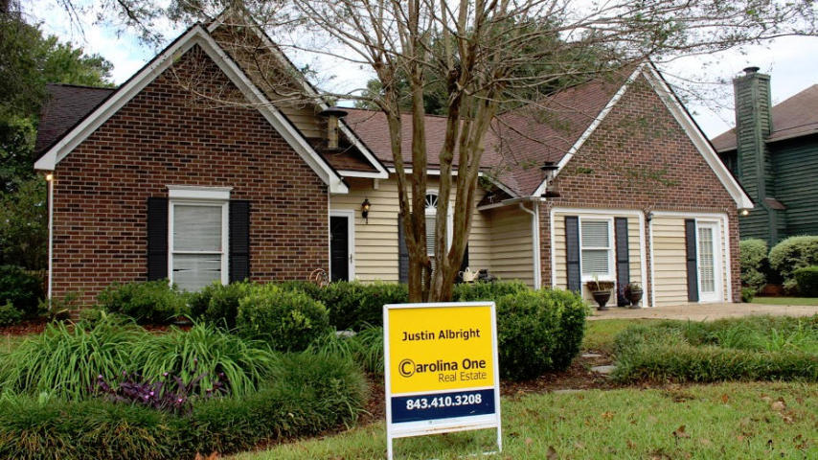


Rice Hollow
Under $300k
1752 W Sandcroft Dr Charleston, SC MLS# 1425101 $295,000 3 Bedrooms | 2½ Baths | 2,165 Sq Ft
Rice Hollow Must See Newly updated 1st floor with bamboo floors, new paint and complete kitchen update with cabinets, granite and appliances. Large back yard great neighborhood to raise children or start a family. Can't beat the neighbors. Orange Grove elementary school is one Charleston's best.
1884 Sandcroft Dr Charleston, SC MLS# 14027241 $275,000 3 Bedrooms | 2 Baths | 2,032 Sq Ft
This 1 story open floor plan is a must see at this price, 3 bed 2 bath, vaulted ceilings, FP 380sqft. Enclosed garage. Fenced rear yard with shed. Great price for Rice Hollow. Seller offering a $4,000 allowance to convert garage back to garage at buyers request. Rice Hollow is a great family oriented neighborhood with great curb appeal and great neighbors.
Justin Albright
O (843) 556-5800
C (803) 466.5787
justinalbright1@yahoo.com
Carolina One Real Estate
873 Orleans Road, Ste 102
Charleston, SC 29407

