Slide 1
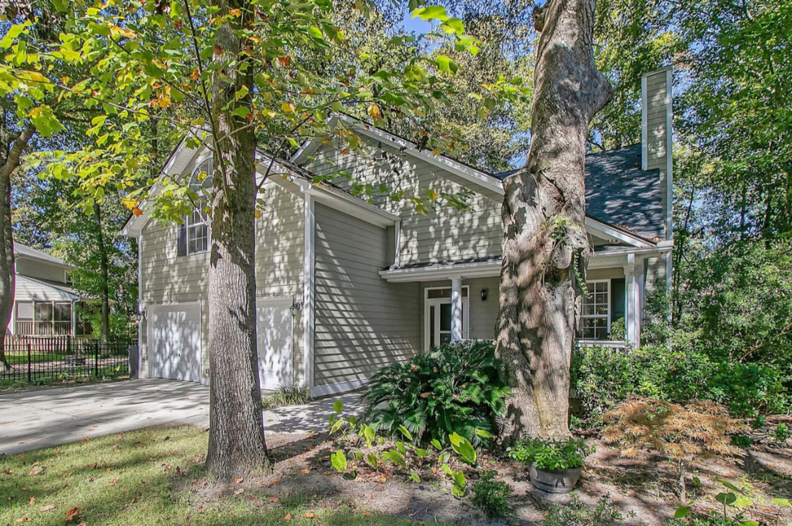
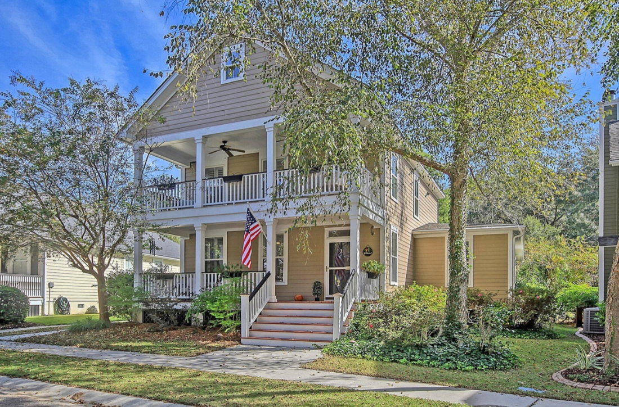
Schieveling Plantation — Dual Open House Weekend
11:00 am to 2:00 Saturday and Sunday
$200 Agent Gift Card Drawing* – Please Join Us!
Bring Your Buyers to Find Out More About Our Home Incentives. Motivated Sellers.
708 Landgrave Avenue
MLS# 23024102
$598,900
4 Bed | 2.5 Bath | 2,520 SF
Sheryl Scholer
Charlestowne Realty LLC
609-306-1901
sheryl@sherylscholer.com
608 Fair Spring Drive
MLS# 23024426
$639,900
4 Bed | 2.5 Bath | 2,491 SF
Paul Smith
EXP Realty LLC
843-367-4292
paul@thepaulsmithteam.com
Agents, we appreciate your time, and in thanks, we are having a $200 gift card drawing!
Agents that have visited both homes (either day) will be eligible for our $200 gift card drawing.
Winner will be announced after the weekend,

