Slide 1

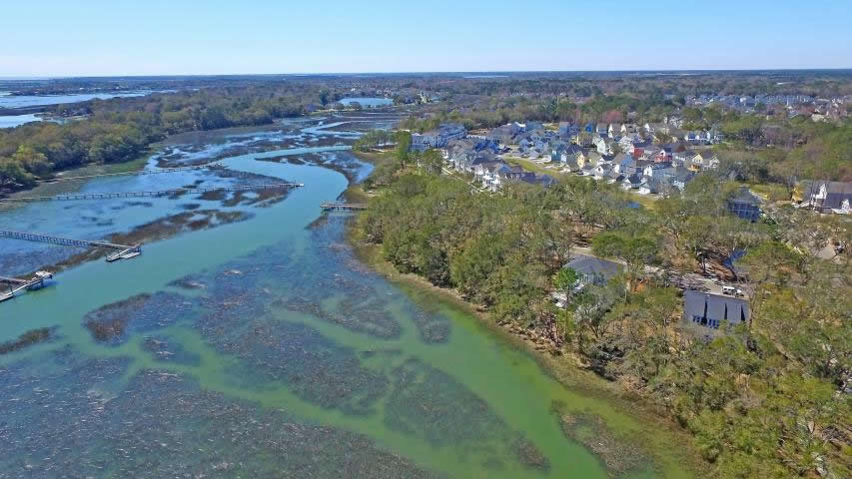


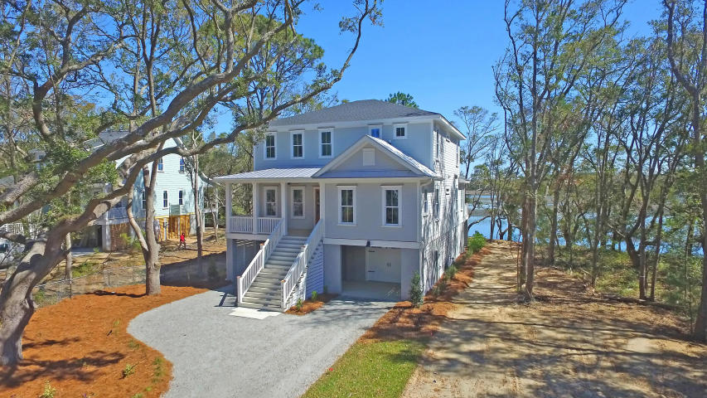
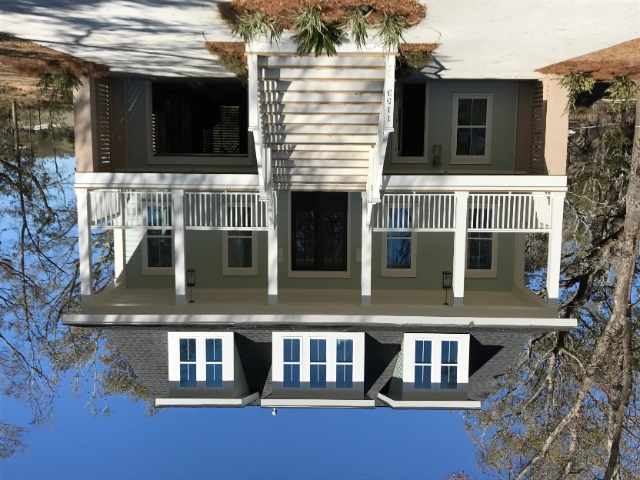
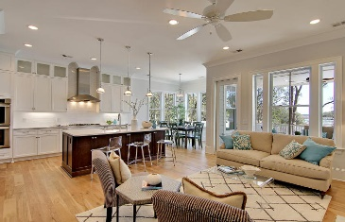
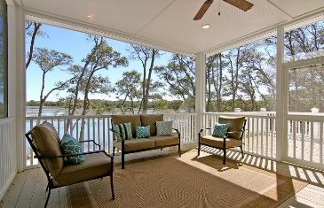
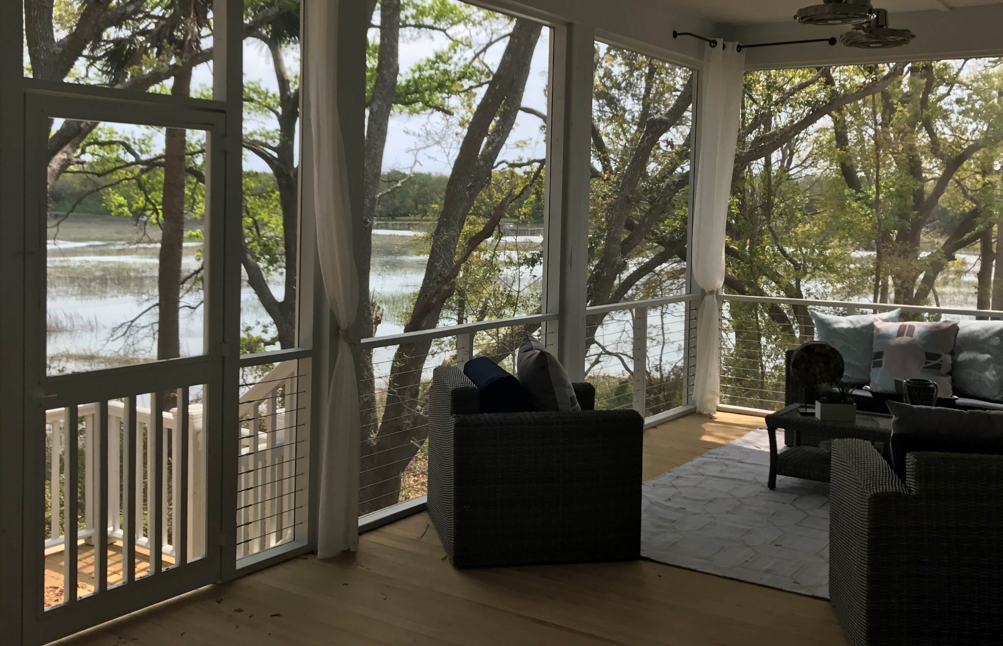


Price Reduced!
Come See Two Wonderful Waterfront Luxury Homes
Wednesday, April 26, 2017 | 4:00 P.M. – 7:00 P.M.
Serving Champaign & Desserts
Wine/Beer/Refreshments & Hors d’oeuvres
1145 Hills Plantation Drive
MLS# 17006586 | $949,900
Matt O'Neill
Matt O'Neill Real Estate
843-532-4220
Matt@mattoneillteam.com
1153 Hills Plantation Drive
MLS# 17006771 | $968,000
Julie Gustavson
New Home Star Coastal
843-478-3540
jgustavson@frontdoorcommunities.com
Book your showing today!
Matt O’Neill matt@mattoneillteam.com 843-532-4220

