Slide 1
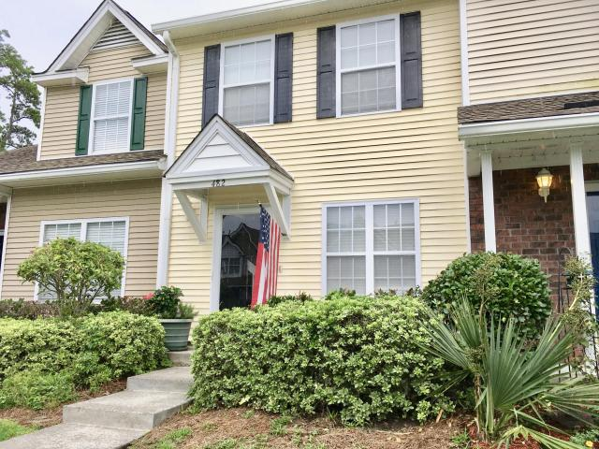
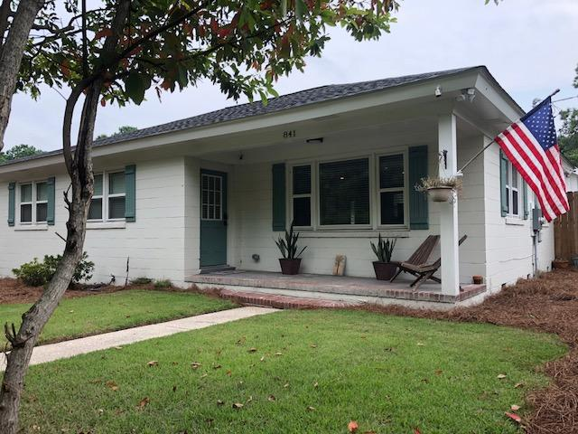
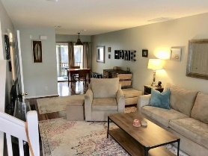
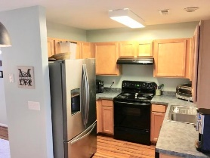
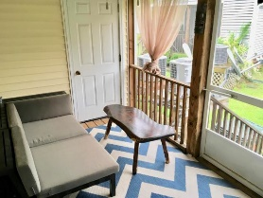
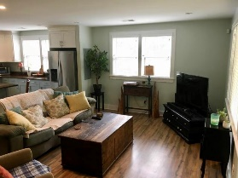
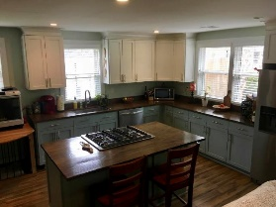
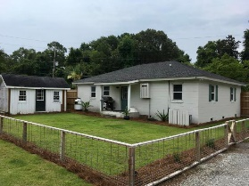


Two Great Investment Opportunities
482 Doane Way
Beresford Commons ~ Charleston
MLS# 18021169 ~ $164,900
A reasonable seller, fairly priced and ready to close. This 2 bedroom, 1.5 bath townhome is cute, clean and efficient. From front to back, this unit is a home waiting to happen for anyone looking for a great location in a quiet spot. With an open floor plan downstairs and two bedrooms up sharing a bathroom, it would be a good idea to see this one soon!
Check out the videos for each property
482 Doane Way
https://www.youtube.com/watch?v=KcwD21bDNT8
841 Long Point Road
https://www.youtube.com/watch?v=JT7uwlL-Smg
841 Long Point Road
Mount Pleasant, SC 29464
MLS# 18020076 ~ $775,000
Exceptionally updated ranch home with an unbelievable 1.10 acres in an amazing Mount Pleasant location! Completely renovated in 2016 all the way down to the electrical wiring. All new appliances and finishes set in a privately fenced area with an automated gate for you to come home and leave the world behind. With sewer being planned now for Longpoint road by Mt. Pleasant Waterworks, you can build and additional home or homes or just have a retreat, mini-farm and grow your own produce. With a chicken coop and an out building, you can have the rural life in a key location that give you the ability to walk to Seacoast, Belle Hall Shopping Center, your doctors or even Chick-Fil-A. Get to 526, Mathis Ferry or Highway 17 in minutes. This could be the be the beginning of your retreat life!
MLS ID: | 18009882
Sale Price: | $784,500
Area: | 41 - Mt Pleasant N of IOP Connector
Bedrooms: | 5
Bathrooms – Full | 4
Apx. SqFt: | 3,372
Year Built: | 2008
Acreage: | 0.2
Tax Map #: | 583-05-00-267
David H Seay
CCIM, BIC, CCIM, REALTOR
(843) 364-6720
david@seaydevelopment.com
Seay Development, LLC
3404-202A Salterbeck Street
Mt. Pleasant, SC 29466
www.seaydevelopment.com

