Slide 1
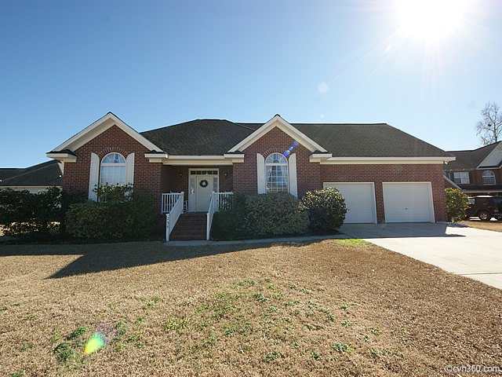
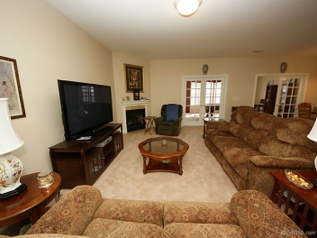
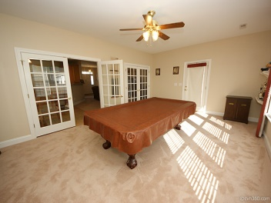
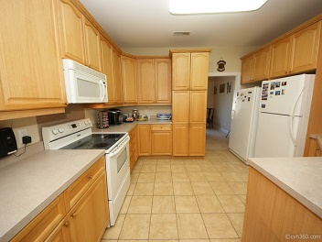
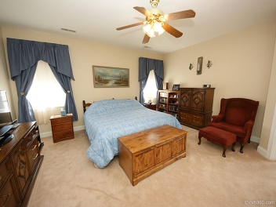
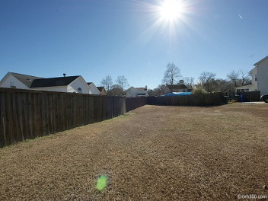
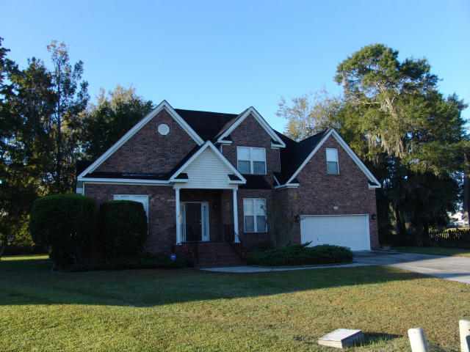
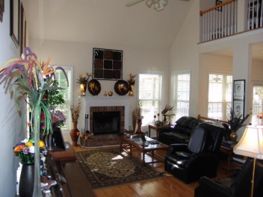
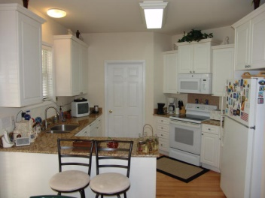
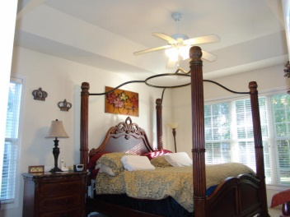
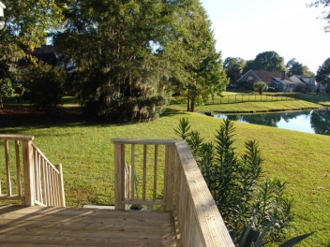
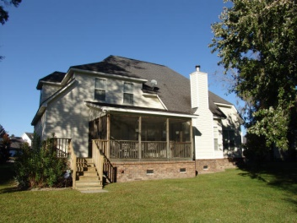
Shadowmoss Plantation Open Houses Saturday, March 14th, from 1-4p
Price Reduced!
235 Harlech Way
MLS# 15001310
Offered at $310,000
Listed by Sandra Siegling
843-343-1119
sandy.siegling@gmail.com
ERA Wilder Realty
241 Harlech Way
MLS# 15005622
$308,000
Listed by Herbert Uthlaut
843-607-9279
herb.uthlaut@cbunited.com
Coldwell Banker United

