Slide 1
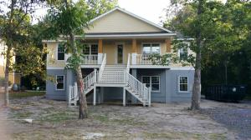
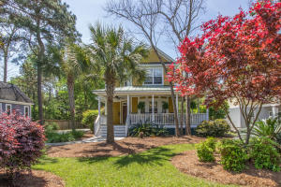
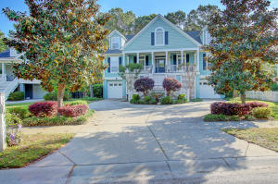
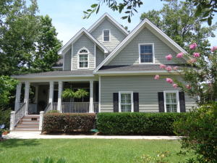
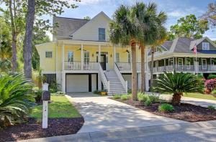
Shell Point Open House Tour
Saturday July 16, 12:00 - 2:00pm
New Construction!
1400 Appling Drive MLS# 16013121
$698,900
Peggy Trenker
The Boulevard Company, LLC
843-345-6644
ptrenker@aol.com
1404 Appling Drive MLS# 16010156
$640,900
Robin Windham
The Brennaman Group
843-991-6672
robinwindham67@gmail.com
1525 Appling Drive MLS# 16010912
$669,000
Brenda Rosenthal
Front Door Realty
843-478-7339
brenda@brenpro.com
1541 Appling Drive MLS# 16017194
$659,900
Teresa Porter
AgentOwned Preferred Group
843-300-5822
teresa.porter@agentownedrealty.com
1324 Parkton Road MLS# 16010315
$649,000
Mark Mizell
Birchin Lane Realty Advisors
843-834-4736
mark@birchinlanerealty.com

