Slide 1
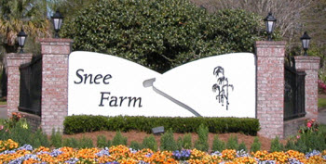
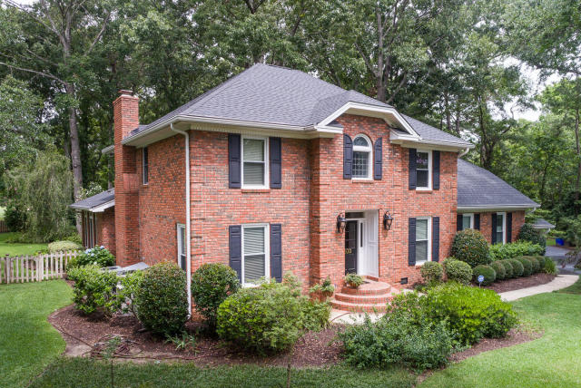
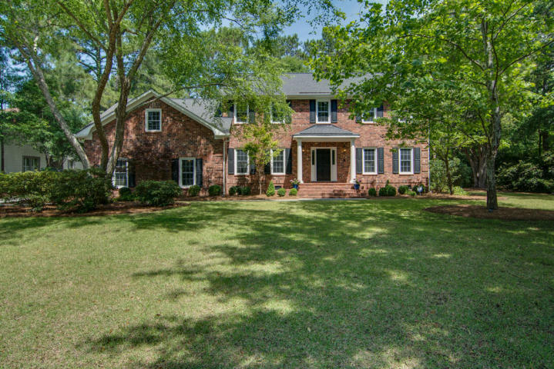
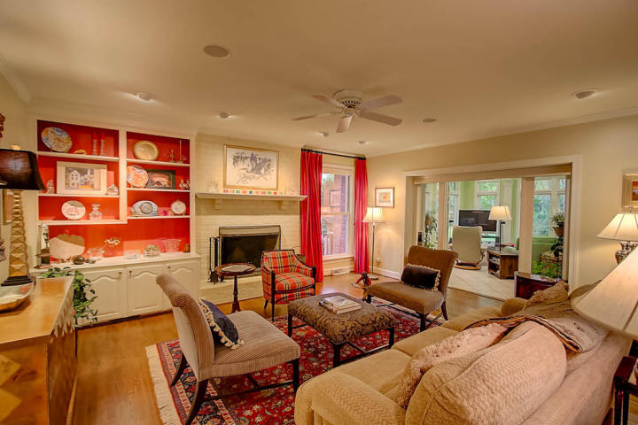
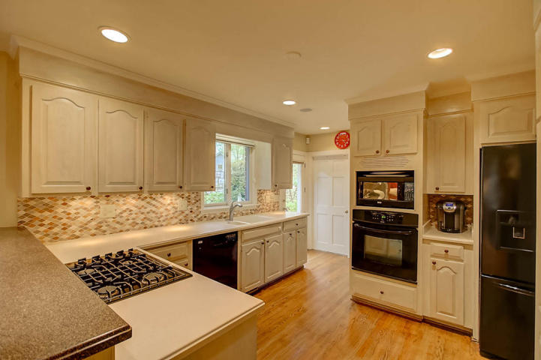
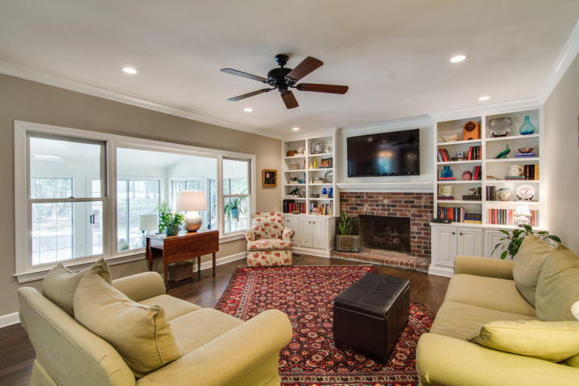
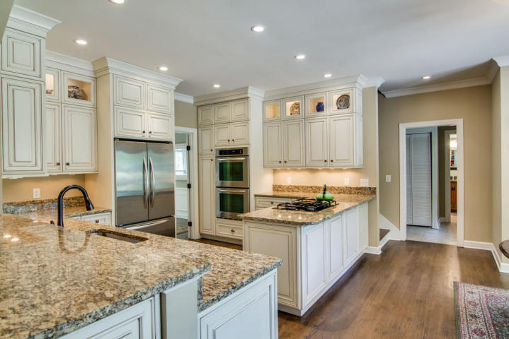
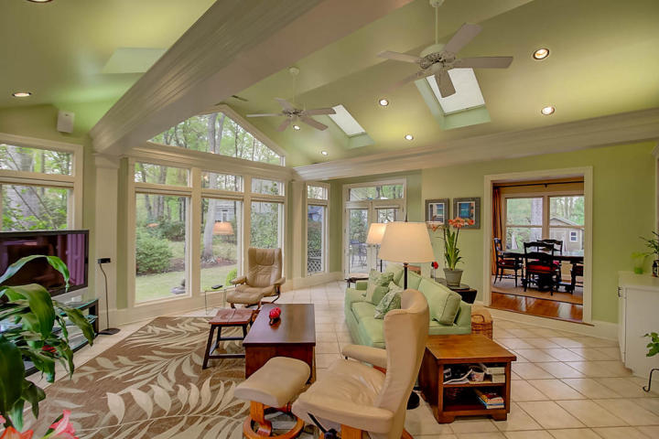
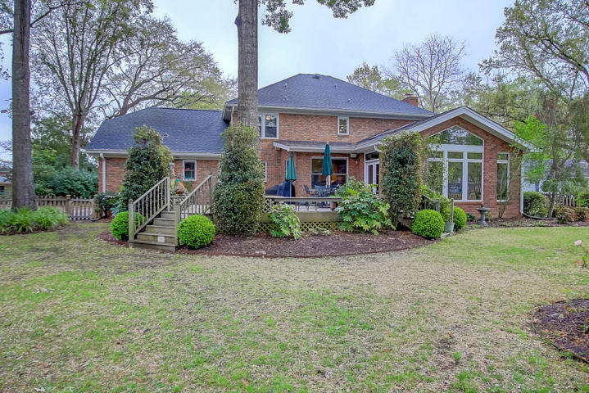
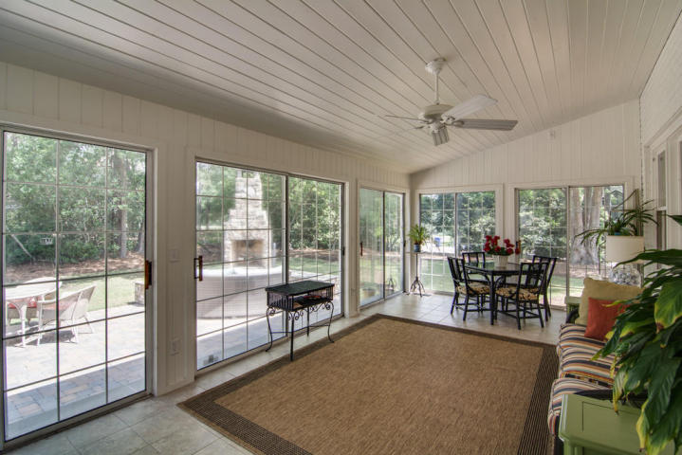
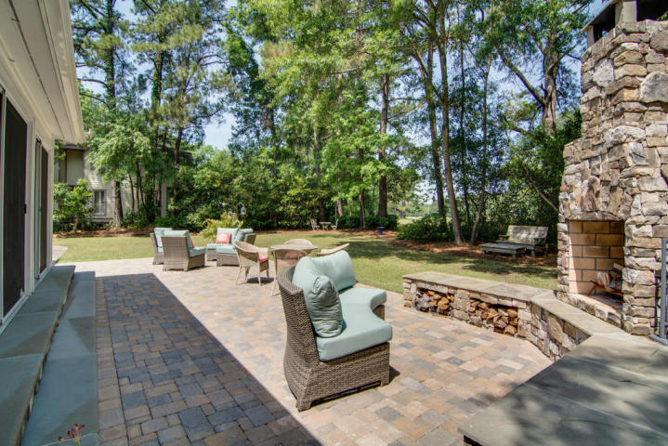


Snee Farm Open Houses ~ Thursday June 15th 11-12:30
Lunch items and refreshments will be provided at both locations. There will be a drawing for a gift card for agents who view both homes.
930 Overview Court
MLS# 17010322 | $810,000
Jan Snook 843-437-3330
jansnook@kw.com
936 Casseque Province
MLS# 17013571 | $825,000
B.V. Messervy 843-452-3630
bvmesservy@carolinaone.com
Keller Williams Realty Charleston
496 Bramson Ct Ste 200
Mt. Pleasant, SC 29464
Carolina One Real Estate
195 W Coleman Blvd
Mt Pleasant, SC 29464-3495

