Slide 1

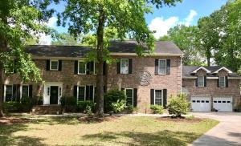
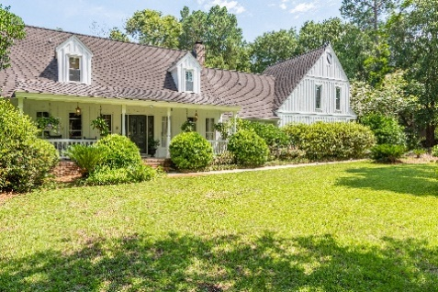
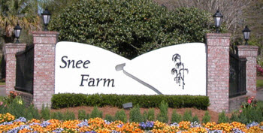
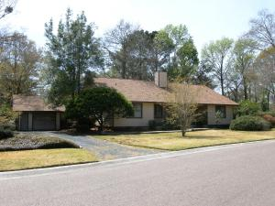
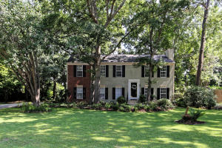
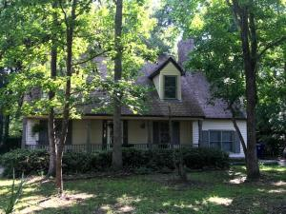
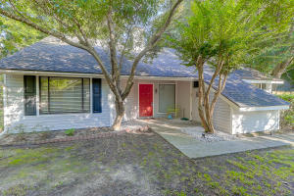
Snee Farm Open Houses
Sunday, July 15th from 2-4
Visit all 5 homes and enjoy some
Wine & Cheese
960 Charter Court
MLS# 18013706 | $912,500
Listed by Jennifer Nipper
AgentOwned Preferred Group
jen@agentownedrealty.com
843-478-1800
1167 Farm Quarter
$799,000
Listed by Mary Beth Bennett
AgentOwned Preferred Group
mbbennett@realestate.com
843-367-1774
1106 Ambling Way
MLS# 18016506 | $459,000
Listed by Ray Garnett
Weichert Palmetto Coast
Ray@WeichertRealtorsPC.com
843-437-5174
1145 Shady Grove Ln.
MLS# 1817950 | $410,000
Listed by Danner Benfield
John Poston & Co.
danner@postonco.com
843-323-7835
975 Colonial Drive
MLS# 18018580 | $385,000
Listed by Jennifer Nipper
AgentOwned Preferred Group
jen@agentownedrealty.com
843-478-1800
1111 Astor Drive
MLS# 18018976 | $350,000
Listed by Jan Snook
Keller Williams Realty Charleston
jansnook@kw.com
843-437-3330

