Slide 1
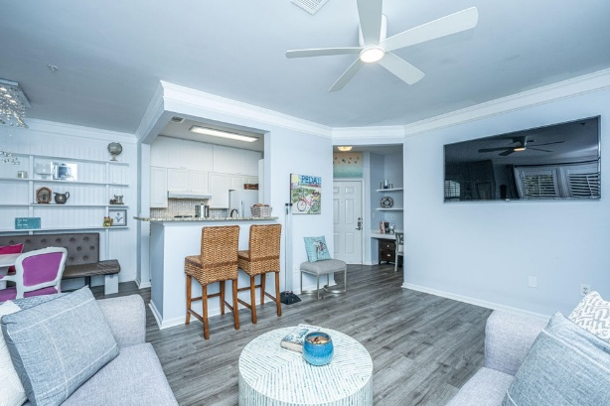
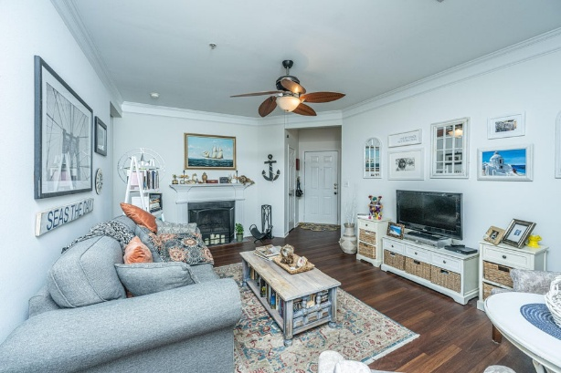
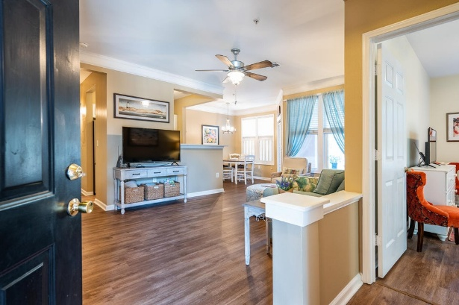
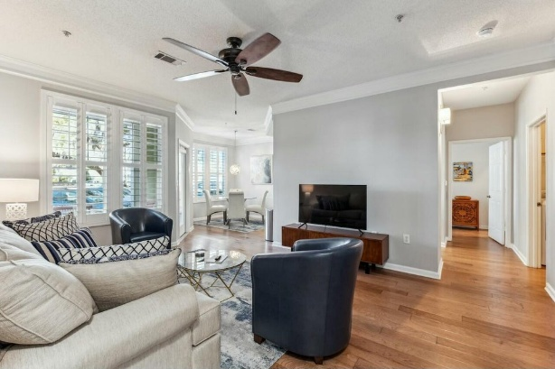
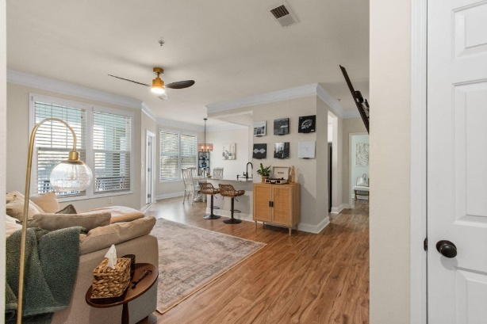
Southampton Pointe Agent Open
Thursday, March 13 from 11 AM-1 PM
1014 Rosewood Lane
MLS# 25002688 | $335,000
Rosalie Martone
Carolina One Real Estate
843-513-3537
rosalie.martone@gmail.com
1928 Chatelain Way
MLS# 25002599 | $445,000
Rosalie Martone
Carolina One Real Estate
843-513-3537
rosalie.martone@gmail.com
1615 Chatelain Way
MLS# 24026812 | $449,900
Renee Meyer
Carolina One Real Estate
843-991-0007
renee@carolinaoneplus.com
1718 Chatelain Way
MLS# 25005209 | $457,000
Kathleen DiMinico
The Boulevard Company
843-816-1643
kathleen@diminicorealty.com
1821 Chatelain Way
MLS# 25006216 | $460,000
Gina Drohan
KV Real Estate LLC
843-830-8982
ginadrohan13@gmail.com

