Slide 1
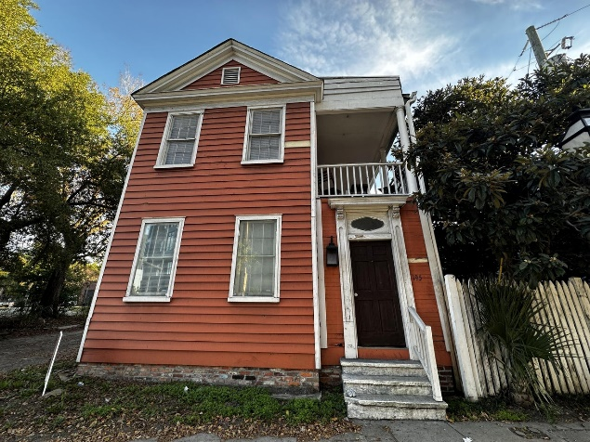
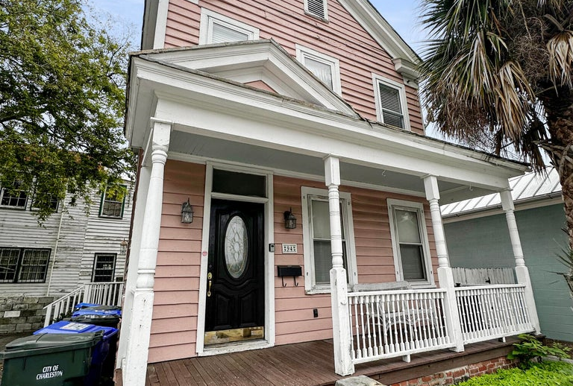



Downtown Charleston Duplexes with parking!
Welcome home to 195 Spring Street, a gorgeous, incoming-producing Charleston Single-style DUPLEX in the heart of Charleston and MINUTES from all it has to offer. 195 Spring is commercially zoned, allowing for different business possibilities! This property was moved from downtown years ago and has hardwood floors throughout the entire property, double porches, newer electric, updated plumbing, newer insulation, and roof replaced within the last 5 years. One of the unique features is a total of 5 fireplaces throughout the entire property. One of the rare finds in downtown Charleston, this property offers ample parking in the rear. 6 parking spots! Parking is often a premium in this historic area, making this feature a valuable asset for both tenants, future customers, new owners.
This property also gets treated quarterly for termites. Don't miss this rare gem!
195 Spring Street
MLS# 23027305
$875,000
Unit 1: SqFt: 1,000; Beds: 2; Baths: 1
Unit 2: SqFt: 792; Beds: 2; Baths: 1
Welcome to 94 Courtenay Drive, a renovated duplex with General Business zoning in the HEART of downtown Charleston. Equipped with 4 off-street parking spaces in a tiny parking lot adjacent to the property, this duplex has LOTS of potential. Possibility to build on adjacent lot! Convert to a single family house, keep as a duplex, open up your own office - the opportunities are numerous! The insulation, plumbing, electric, wood, windows, HVAC and roof are replaced within the last 5 years. One of the rare finds in downtown Charleston, this property offers its own small ''parking lot''. Parking is often a premium in this historic area, making this feature a valuable asset for both tenants, future customers, new owners.
This property also gets treated quarterly for termites. Don't miss out on this rare gem!
94 Courtenay Drive
MLS# 23027223
$775,000
Unit 1: SqFt: 540; Beds: 1; Baths: 1
Unit 2: SqFt: 540; Beds: 1; Baths: 1
Nick Mazzilli (843) 640-5575
nick@nickmcharleston.com nickmavencharleston.com
Maven Realty
2180 McMillan Ave
#71672
Charleston, SC 29405

