Slide 1
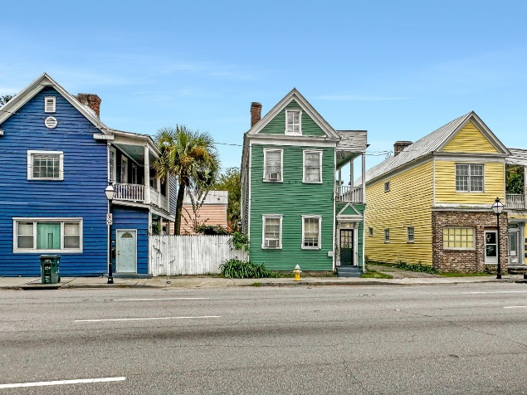
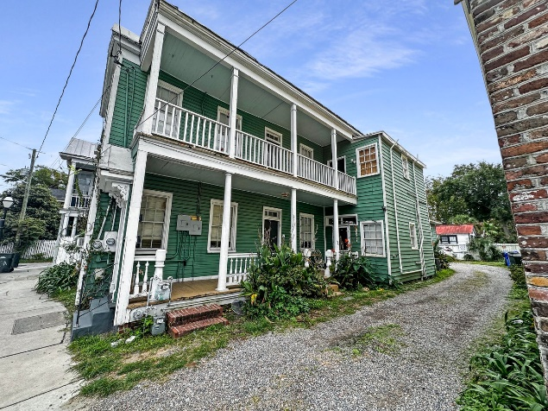
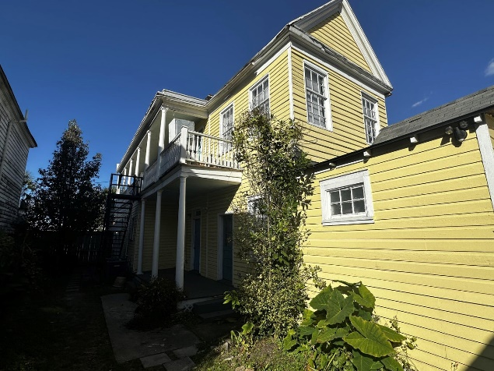



Downtown Charleston Multifamily Properties
197 Spring Street
MLS# 23027222
$825,000
Unit 1: SqFt: 1,000; Beds: 2; Baths: 1
Unit 2: SqFt: 908; Beds: 2; Baths: 1
199 Spring Street
MLS# 23027276
NEW PRICE $995,000
Unit 1: Beds: 1; Baths: 1
Unit 2: Beds: 1; Baths: 1
Unit 3: Beds: 1; Baths: 1 Unit 4: Beds: 1; Baths: 1
Unit 5: Beds: 1; Baths: 1
201 Spring Street
MLS# 23027306
NEW PRICE $995,000
Unit 1: Beds: 1; Baths: 1
Unit 2: Beds: 2; Baths: 1
Unit 3: Beds: 2; Baths: 2
Unit 4: Beds: 1; Baths: 1
Welcome home to 197 Spring Street, a gorgeous, incoming-producing Charleston Single-style duplex in the heart of Charleston and MINUTES from all it has to offer. 197 Spring is commercially zoned, allowing for different business possibilities! This property has hardwood floors throughout the entire property, double porches, new roof within the last 5 years, newer HVACs, and painted within the last few years. One of the rare finds in downtown Charleston, this property offers ample parking in the rear. Parking is often a premium in this historic area, making this feature a valuable asset for both tenants, future customers, new owners.
This property also gets treated quarterly for termites. Don't miss out on this rare gem in the heart of downtown Charleston!
Welcome home to 199 Spring Street, a gorgeous, incoming-producing Charleston Single-style multifamily in the heart of Charleston and MINUTES from all it has to offer. 199 Spring is commercially zoned, allowing for different business possibilities! This property consists of a few units; 2 studios, 1 apartment, and 2 larger units - one on each floor. Each unit is 1 bedroom (formal or studio) and 1 bathroom but all vary in size. 199 Spring has hardwood floors throughout the entire property, double porches, roof recoated within the last 5 years. One of the rare finds in downtown Charleston, this property offers ample parking in the rear. Parking is often a premium in this historic area, making this feature a valuable asset for both tenants, future customers, new owners.
This property also gets treated quarterly for termites. Don't miss this rare gem in the heart of downtown!
Welcome home to 201 Spring Street, a gorgeous, incoming-producing Charleston Single-style QUADPLEX in the heart of Charleston and MINUTES from all it has to offer. 201 Spring is commercially zoned, allowing for different business possibilities! If rents are increased, Projected Gross income can fetch up to $7,200/month. This property has 3 units; 1 large studio, 1 detached studio apartment and 2 larger units - one on each floor. Unit A is currently vacant and gives the opportunity to owner occupy or rent. They're hardwoods throughout the entire property, plus double porches, roof recoated within the last 5 years. One of the rare finds in downtown Charleston, this property offers ample parking in the rear.
Parking is often a premium in this historic area, making this feature a valuable asset for both tenants, future customers, new owners. This property also gets treated quarterly for termites.
Nick Mazzilli (843) 640-5575
nick@nickmcharleston.com nickmavencharleston.com
Maven Realty
2180 McMillan Ave
#71672
Charleston, SC 29405

