Slide 1
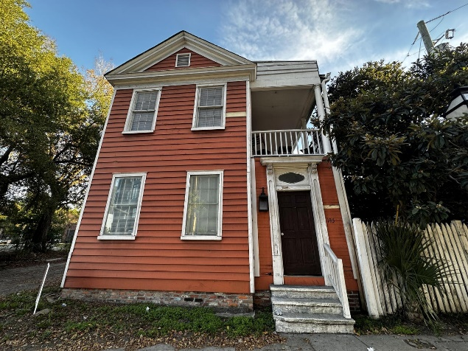
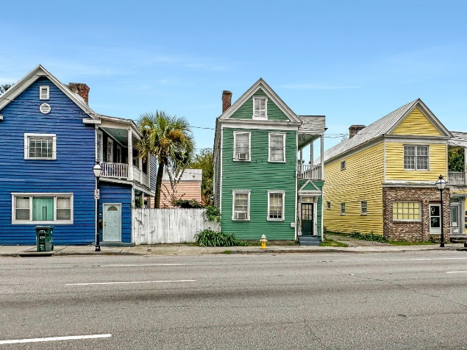
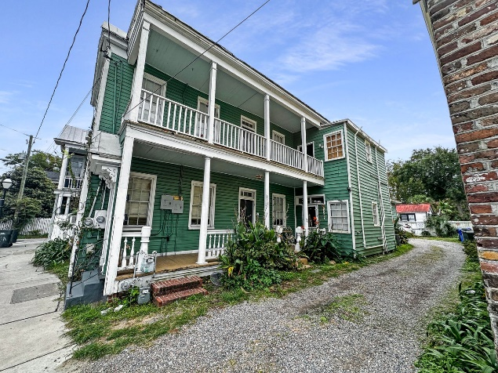
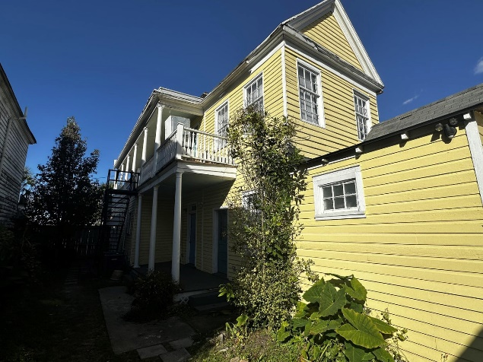
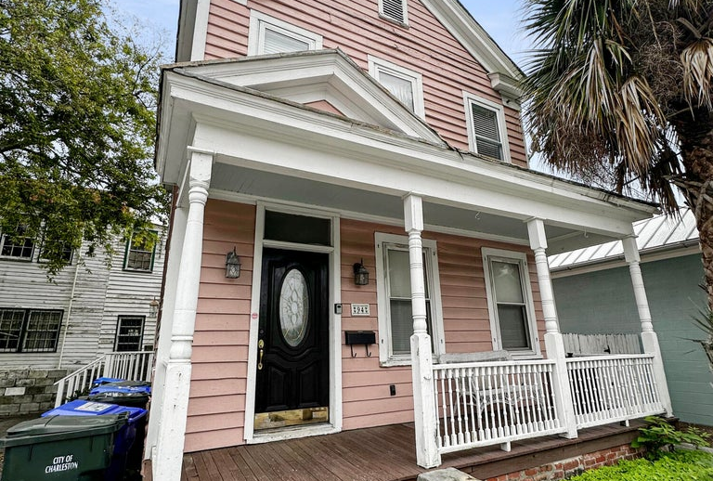



Spring Street Portfolio (15 Doors)
195 Spring Street
MLS# 23027305
$875,000
Unit 1: SqFt: 1,000; Beds: 2; Baths: 1
Unit 2: SqFt: 792; Beds: 2; Baths: 1
197 Spring Street
MLS# 23027222
$850,000
Unit 1: SqFt: 1,000; Beds: 2; Baths: 1
Unit 2: SqFt: 908; Beds: 2; Baths: 1
199 Spring Street
MLS# 23027276
$1,075,000
Unit 1: Beds: 1; Baths: 1
Unit 2: Beds: 1; Baths: 1
Unit 3: Beds: 1; Baths: 1 Unit 4: Beds: 1; Baths: 1
Unit 5: Beds: 1; Baths: 1
This Spring Street portfolio consists of 15 units split between 5 different multifamily properties. These are all zoned General Business commercial. One of the rare finds in downtown Charleston, these properties offer ample parking on the rear or side. Parking is often a premium in this historic area, making this feature a valuable asset for both tenants, future customers, new owners. Just a short walk to Roper St Francis/MUSC and plenty of restaurants, bars, downtown fun! This property also gets treated quarterly for pest control. Rent roll and utility info available upon request. Total list price $4.7M.
201 Spring Street
MLS# 23027306
$1,125,000
Unit 1: Beds: 1; Baths: 1
Unit 2: Beds: 2; Baths: 1
Unit 3: Beds: 2; Baths: 2
Unit 4: Beds: 1; Baths: 1
94 Courtenay Drive
MLS# 23027223
$775,000
Unit 1: SqFt: 540; Beds: 1; Baths: 1
Unit 2: SqFt: 540; Beds: 1; Baths: 1
Nick Mazzilli (843) 640-5575
nick@nickmcharleston.com nickmavencharleston.com
Maven Realty
2180 McMillan Ave
#71672
Charleston, SC 29405

