Slide 1
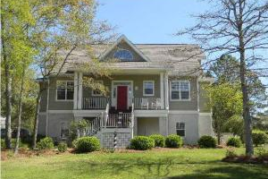
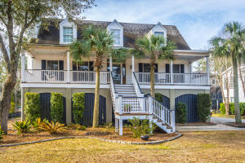
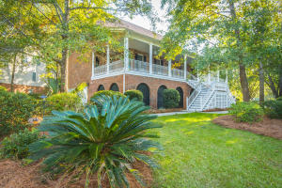


St Thomas Point Progressive Agent Caravan Thursday, March 8th ~ 11:00 - 1:00 Lunch and Dessert provided $50 Visa Card drawing for those viewing all three properties
216 Ashmont Drive
MLS# 17018706
$499,900
Frank Rutigliano
843-813-4961
frutigliano@kwchs.com
Keller Williams Realty Chas. Islands
219 Ashmont Drive
MLS# 18004496
$488,000
Justin Jureka
843-290-3272
jjureka@carolinaoneplus.com
Carolina One Real Estate
109 Berkshire Drive
MLS# 17030068
$625,000
Debbie Rogers
843-990-2915
deborah.rogers@carolinaone.com
Carolina One Real Estate
Frank Rutigliano
843-813-4961
frutigliano@kwchs.com

