Slide 1
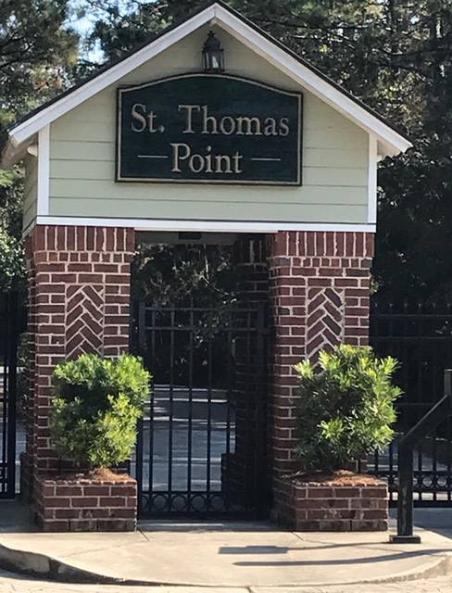
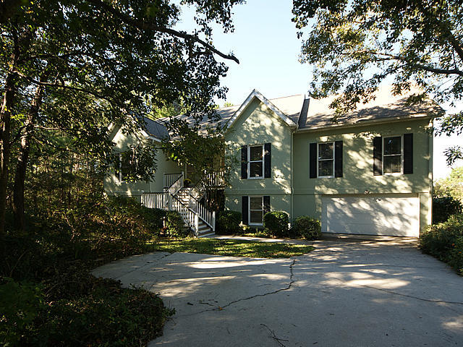
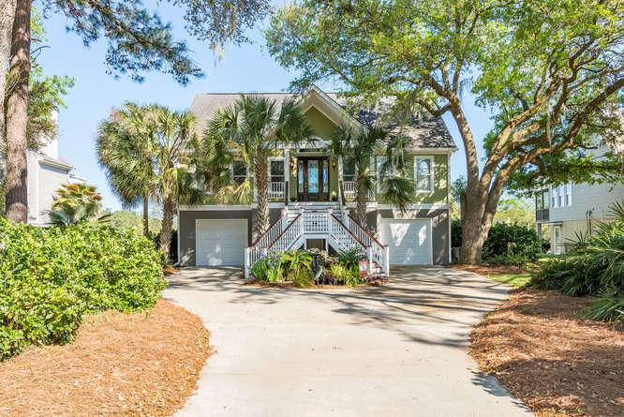
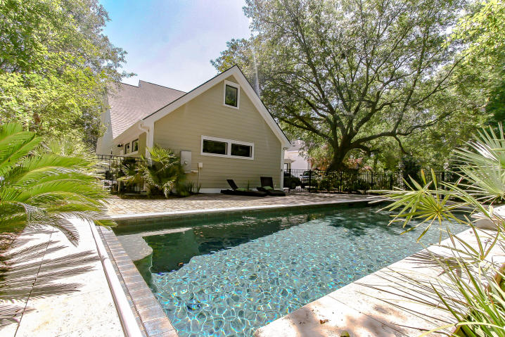
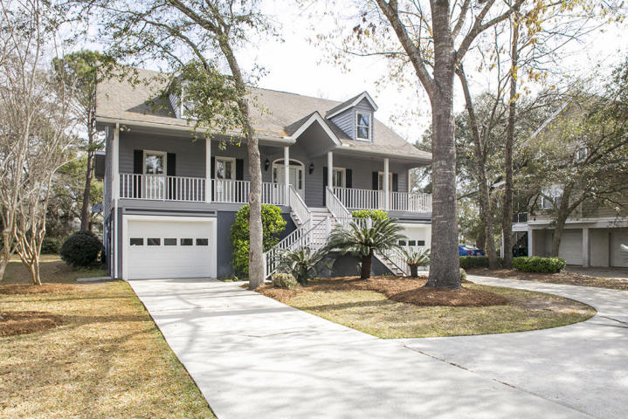
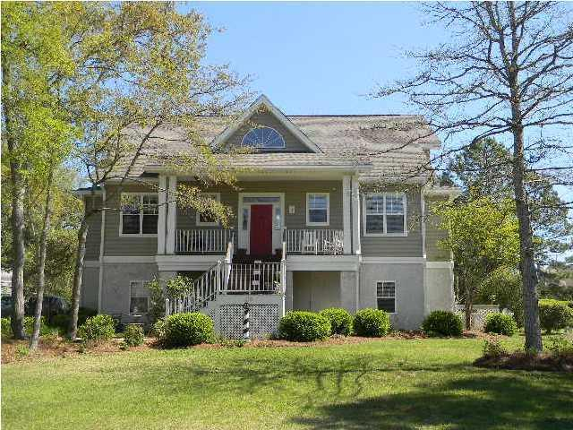
St Thomas Point Open House Wednesday, August 2nd, 11a - 1p Visit All 5 Homes To Qualify For A $200 Visa Gift Card Raffle
106 Berkshire Drive
MLS# 16026530 | $549,000
Elizabeth Shirley
lizshirleyrealestate@gmail.com
843-276-2970
BHHS Carolina Sun Real Estate
126 Berkshire Drive
MLS# 17009144 | $649,900
Julie O'Reilly
joreilly@kw.com
843-514-7851
Keller Williams Realty Charleston
121 Berkshire Drive
MLS# 17010616 | $743,000
Neil Schneider
neil@charleston.info
843-200-8902
AgentOwned Preferred Group
Light Lunch & Dessert
214 Ashmont Drive
MLS# 17006570 | $520,000
Bart Jackson
Bart@CharlestonPreferred.com
843-224-8944
Charleston Preferred Properties
216 Ashmont Drive
MLS# 17018706 | $514,900
Frank Rutigliano
frutigliano@kwchs.com
843-813-4961
Keller Williams Realty Chas. Islands

