Slide 1

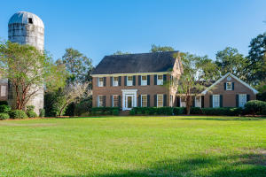
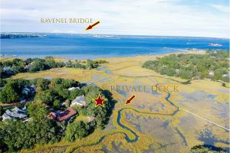

693 Whispering Marsh Drive MLS# 18024303 ~ $799,900
Just Reduced $785,000!
Stiles Point Plantation
Open Houses & Progressive Lunch
Friday, November 30 from 11:00am - 1:00pm
915 Paul Revere Court MLS# 18030873 ~ $925,000
Ellen Leigh Murray
Charleston Premier Properties
843-813-2006
chaspremierprop@bellsouth.net
Helen Butler
William Means Real Estate
843-343-2222
hbutler@williammeans.com
897 Kushiwah Creek Court MLS# 18029855 ~ $1,450,000
Shane & Tara Spurling
Matt O'Neill Real Estate
843-732-1945
shane@mattoneillteam.com

