Slide 1
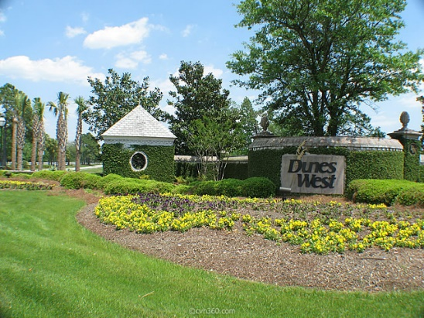
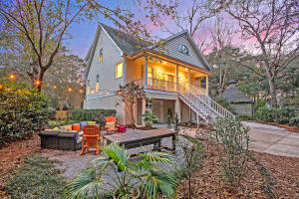

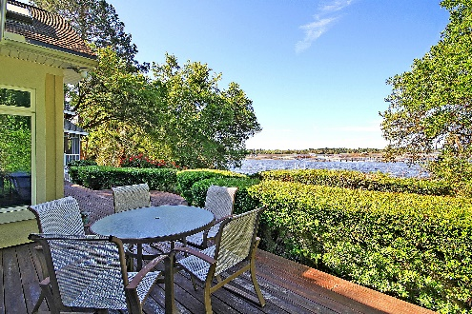
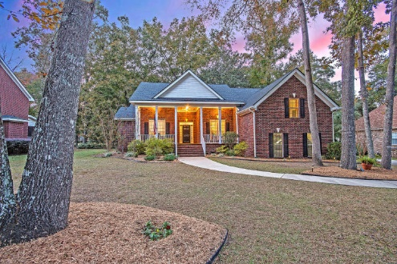
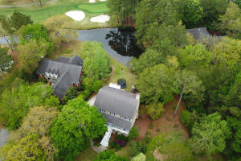
Stono Ferry Open House Tour
Saturday, April 27th from 1-4
$100 Gift Card Drawing Giveaway!
5189 Stablegate Lane
MLS# 19004267
$444,000
Christopher Smith
843-267-0735
christopher@mattoneillteam.com
Matt O'Neill Real Estate
4919 Polo Lane
MLS# 19011218
$514,900
Tami Gordon
843-568-1132
tami@jimmillsteam.com
AgentOwned Premier Group
Refreshments will be served!
4941 Steeplechase Lane
$699,000
Missy Reid & Lisa Quick
843-619-0401 | 843-452-6688
missy@mattoneillteam.com
lisa@mattoneillteam.com
Matt O'Neill Real Estate
5201 Forest Oaks Drive
MLS# 18032345
$409,000
Missy Reid
864-934-5447
missy@mattoneillteam.com
Matt O'Neill Real Estate
5104 St Ann Lane
MLS# 19010249
$528,900
Dan Lorentz
843-532-4653
dan@danlorentz.com
The Boulevard Company
** Agents: please plan to show your pocket card at the gate **

