Slide 1
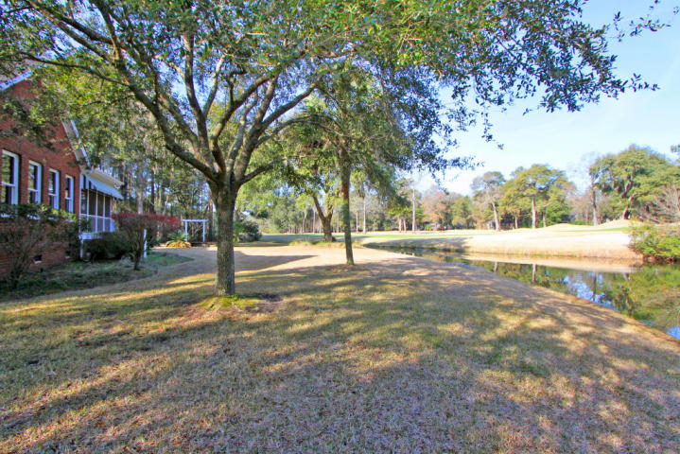
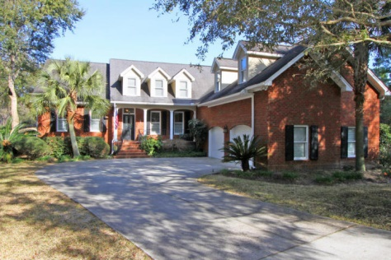
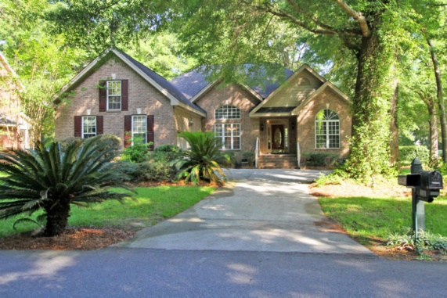
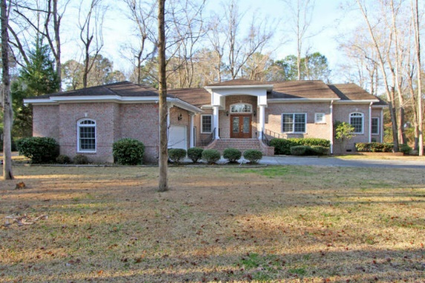



Stono Ferry Open Houses Thursday July 16 11:00 to 1:00 Golf Course Community, Hollywood just 17 miles south of Downtown Charleston
5108 Saint Ann Lane MLS# 15003930 ~ $575,000
3 Bedroom ~ 2½ Bath
Privacy, views, spacious living areas, countless features, and views of pond and 15th and 16th fairways. -Lovely brick home with Master bedroom and living areas downstairs -Open kitchen with granite counter tops and separate butler's pantry and 2 ovens -Spacious master suite has private door to the sun room -Master bath with split vanities, huge shower, walk in closet and bidet -Sun room enclosed with lots of windows for excellent views -Additional screened porch over looking golf course -Very large room over the garage This home is beautifully cared for and maintained. The Stono Ferry community is a peninsula reaching into the Stono Intercoastal Waterway and Log Bridge Creek. Besides the semi-private Links at Stono Ferry, the community offers a junior Olympic pool, lighted tennis courts, two polo fields, equestrian facility, and community social events. Stono Ferry Homeowners Association charges a 1/4 of one percent transfer fee to be paid by buyers. For square footage please measure.
4771 Marshwood Drive MLS# 15016353 ~ $389,000 4 Bedroom ~ 2 Bath
4977 Old York Course MLS# 15004885 ~ $540,000
3 Bedroom ~ 3½ Bath
Complete Action Real Estate Services, Inc.
Caprice Atterbury
Broker-in-Charge
843-425-9817 - Mobile
caprice@caresrealestate.com
Dan Amigone
Broker Associate
843-364-2888 - Mobile
daniel@caresrealestate.com

