Slide 1
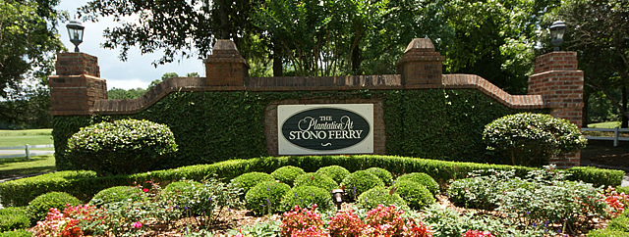
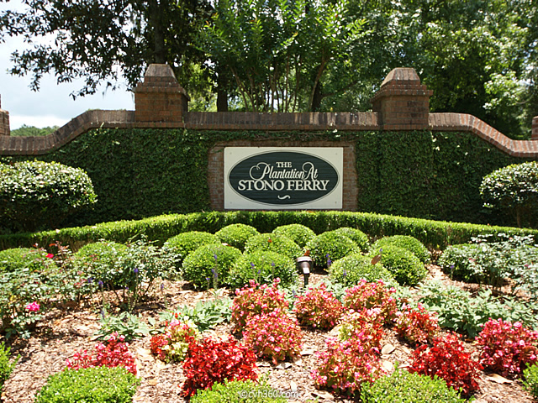
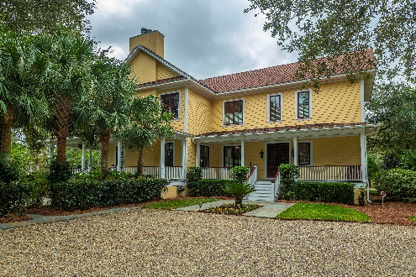
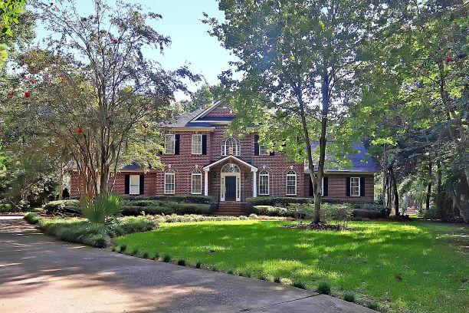
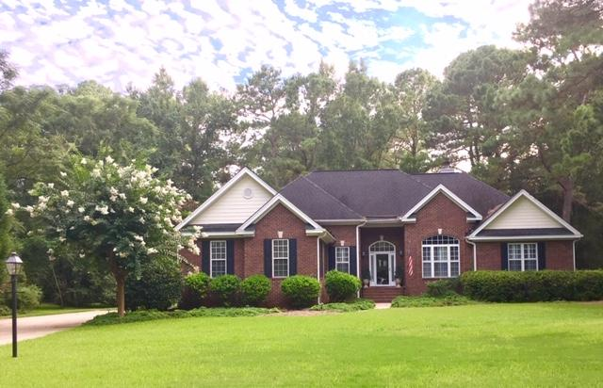
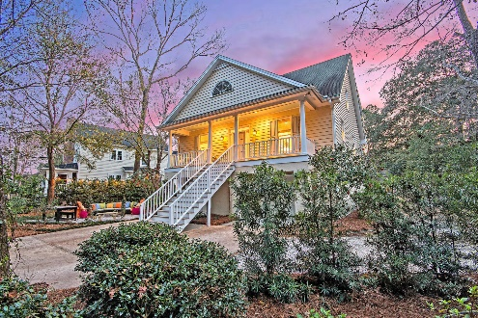
Stono Estates & Stono Ferry
Realtor Open House Event
Thursday, October 17 11:00 AM – 1:00 PM
Join us for a tour of these three beautiful properties with wonderful food! Drawings at every property to win up to $200!
4712 Silver Oak Lane
Stono Estates
5 Bed/4 Bath/3,990 sf
$739,000
Janet Newham
843.860.9672
jnewham@carolinaone.com
Serving Mrs. Hamby’s luncheon catering & lemonade. Drawing for a $100.00 VISA Gift Card.
5189 Stablegate Lane
5 Bed/2.5 Bath/2,160 sf
$389,950
Christopher Smith
843-267-0735
christopher@mattoneillteam.com
Serving To be determined along with drawing.
4962 Steeplechase Lane
Stono Ferry
5 Bed/3.5 Bath/3,502 sf
$625,000
Meg Watson
843.697.9985, meg.charlestonhomes@gmail.com
Serving Sausage & egg casserole, croissants & orange juice. Drawing for a $50.00 Publix Gift Card.
5023 Timber Race Course
Stono Ferry
3 Bed/3 Bath/2,582 sf
$468,000
Danielle Kenney
843.442.2848
dkenney@carolinaone.com
Serving Ham Sandwiches & beverages. Drawing for a $50.00 VISA Gift Card.
** Agents: please plan to show your pocket card at the gate **

