Slide 1
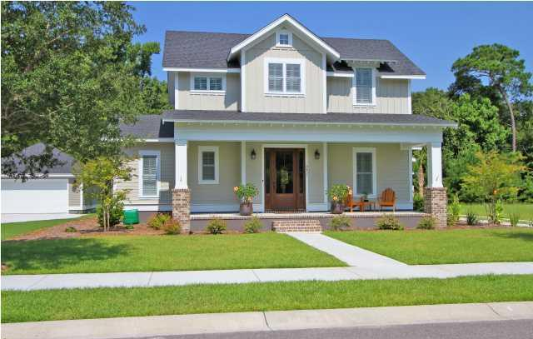
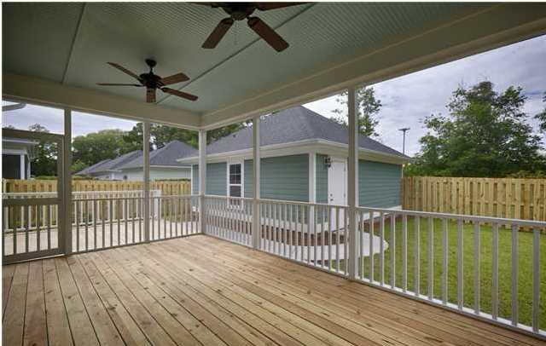
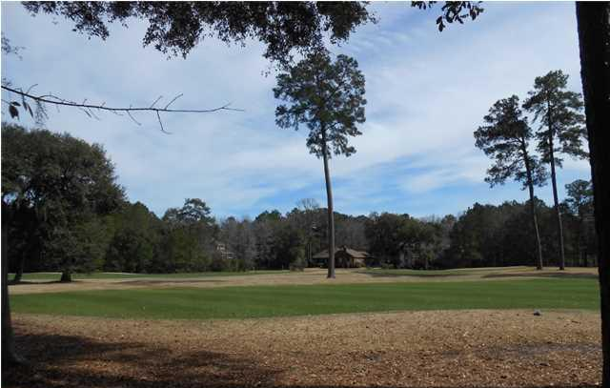
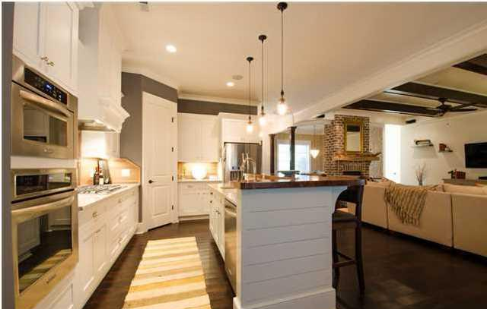
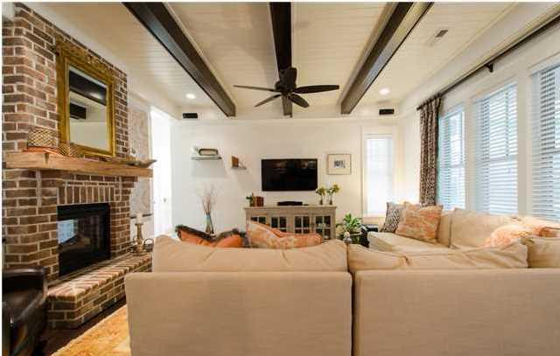
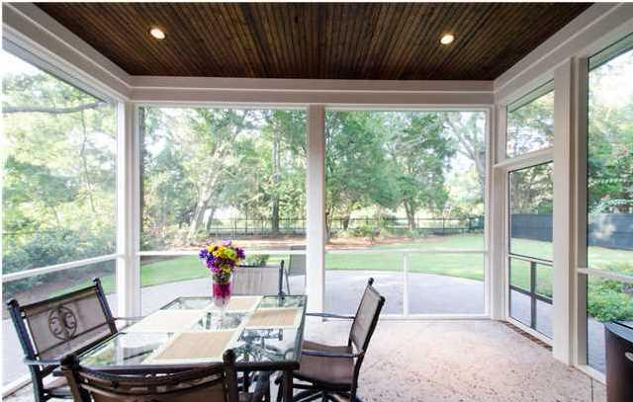
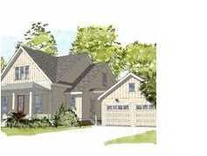
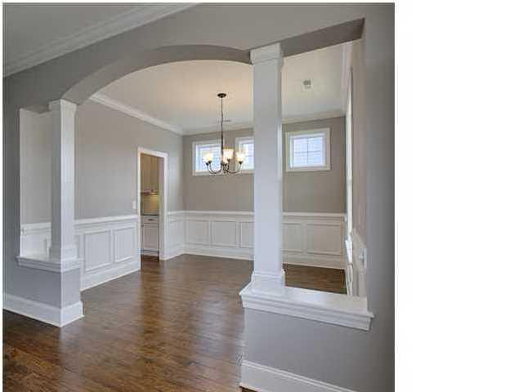
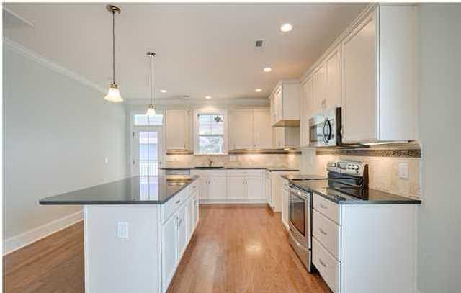

Three Brand New Homes To Choose From On The Golf Course At Stono Ferry
5-6 Months From Completion… Send Your Clients Now To Select Finishes
5170 Forest Oaks Dr - MLS# 1405116 - $495,000
New construction in beautiful Stono Ferry. Prism Award winning local builder. This is an awesome floor plan which will take advantage of the long range views down the 15th and 16th fairway of The Links at Stono Ferry Golf Course. This home has a very open floor plan which features 4 bedrooms, 3.5 baths and a downstairs master bedroom. 3 large bedrooms and 2 full baths plus a loft/office area complete the upstairs. This home will be completely upgraded and impress from the minute you walk in. Some features include hardwood floors throughout the downstairs including the master bedroom-Open kitchen with granite counter tops-42'' cabinets-Stainless steele appliances-Crown Molding all downstairs-Ceramic tile in all bathrooms-Tankless hot water heater-Custom Tiled shower in master bath-Granite counter tops in master bath-Low E windows-Large screened porch-Separate dining room-Laundry room with cabinets and sink-Detached 2 car garage with covered breezway-Plus many more. If you get in early you can choose the majority of fixtures and finishes to truly make this a home suited to your tastes. Stono Ferry is a gated community with an 18 hole championship golf course, lighted tennis courts, Jr. olympic sized swimming pool and is surrounded by the Intra-Coastal waterway and Log Bridge Creek. A very unique and private setting with an abundance of wildlife and many Grand Oak trees make Stono Ferry a great place to call home.
4786 Stono Links Drive - MLS# 1405126 - $495,000
New construction in beautiful Stono Ferry. Prism Award winning local builder. This is a very functional floor plan which will take advantage of views of the 18th fairway and green of The Links at Stono Ferry Golf Course. This home has a very open floor plan which features 4 bedrooms, 3.5 baths and a downstairs master bedroom. 2 large bedrooms and a full bath plus a huge bonus room complete the upstairs. This will be an upgraded home that will impress from the minute you walk in. Some features include hardwood floors throughout the downstairs including the master bedroom-Open kitchen with granite counter tops-42'' cabinets-Stainless steele appliances-Crown Molding all downstairs-Ceramic tile in all bathrooms-Tankless hot water heater-Custom Tiled shower in master bath-Granite counter tops and dual vanities in master bath-Low E windows-Large screened porch-Separate dining room-Laundry room with cabinets and sink-2 car garage-Plus many more. If you get in early you can choose the majority of fixtures and finishes to truly make this a home suited to your tastes. Stono Ferry is a gated community with an 18 hole championship golf course, lighted tennis courts, Jr. olympic sized swimming pool and is surrounded by the Intra-Coastal waterway and Log Bridge Creek. A very unique and private setting with an abundance of wildlife and many Grand Oak trees make Stono Ferry a great place to call home.
4774 Stono Links Dr - MLS# 1418155 - $449,000
New construction in beautiful Stono Ferry. Prism Award winning local builder. House design takes advantage of views of the 18th fairway. Walk to the clubhouse from this lot. This is a very open floor plan with the family room and master bedroom on the back of the house to take advantage of the golf views. This will be an upgraded home that will impress from the minute you walk in. Some features include hardwood floors-Open kitchen with granite counter tops-42" cabinets-Stainless steele appliances-Crown Molding all downstairs-Ceramic tile in all bathrooms-Tankless hot water heater-Custom Tiled shower in master bath-Granite counter tops and dual vanities in master bath-Low E windows-Large screened porch-Laundry room-2 car detached garage with covered breezeway-Plus many more. If you get in early you can choose the majority of fixtures and finishes to truly make this a home suited to your tastes. Stono Ferry is a gated community with an 18 hole championship golf course, lighted tennis courts, Jr. olympic sized swimming pool and is surrounded by the Intra-Coastal waterway and Log Bridge Creek. A very unique and private setting with an abundance of wildlife and many Grand Oak trees make Stono Ferry a great place to call home.
Rob Sturm
M 843-478-2404
rsturm@century21properties.com
Bud Poston
M 843-697-3786
bposton@century21properties.com
Century 21 Properties Plus | 3301 Salterbeck St Suite 100 | Mt. Pleasant, SC 29466
Some of the images above are meant to be representative of the types of finishes available.

