Slide 1
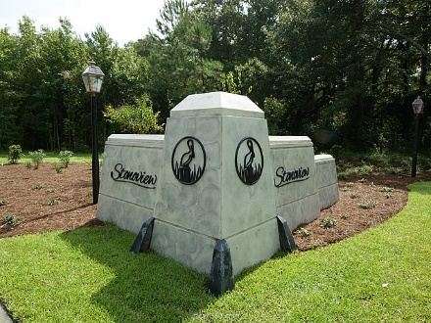
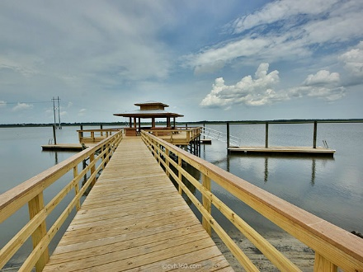
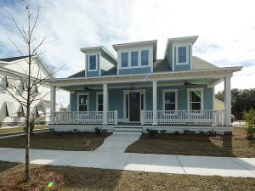
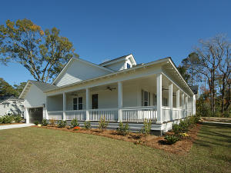
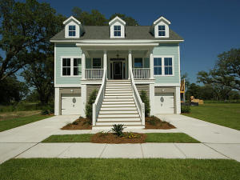
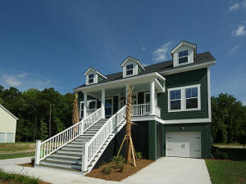


Open House Saturday 12-3 Refreshments Provided
Stonoview
$2,500 Bonus
with ratified contract by 31 August
2639 Battle Trail Drive
MLS# 17015720 | $464,900
3 Bed / 3.5 Bath
2684 Battle Trail Drive
MLS# 17015717 | $409,900
3 Bed / 3.5 Bath
2409 Lieutenant Dozier Drive
MLS# 17015642 | $474,900
3 Bed / 2.5 Bath
2654 Colonel Harrison
MLS# 17015640 | $464,900
3 Bed / 2.5 Bath
Donna Evans
REALTOR, ABR, CRS, EPRO, GRI
(843) 568-3948
donnaevans.realtor@gmail.com | www.comeliveincharleston.com
The Boulevard Company, LLC | 35 Broad Street | Charleston, SC 29401

