Slide 1
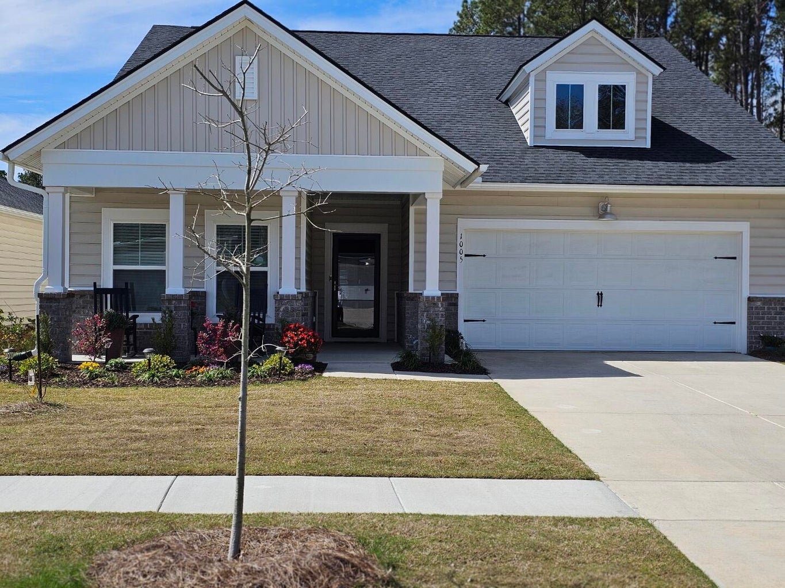

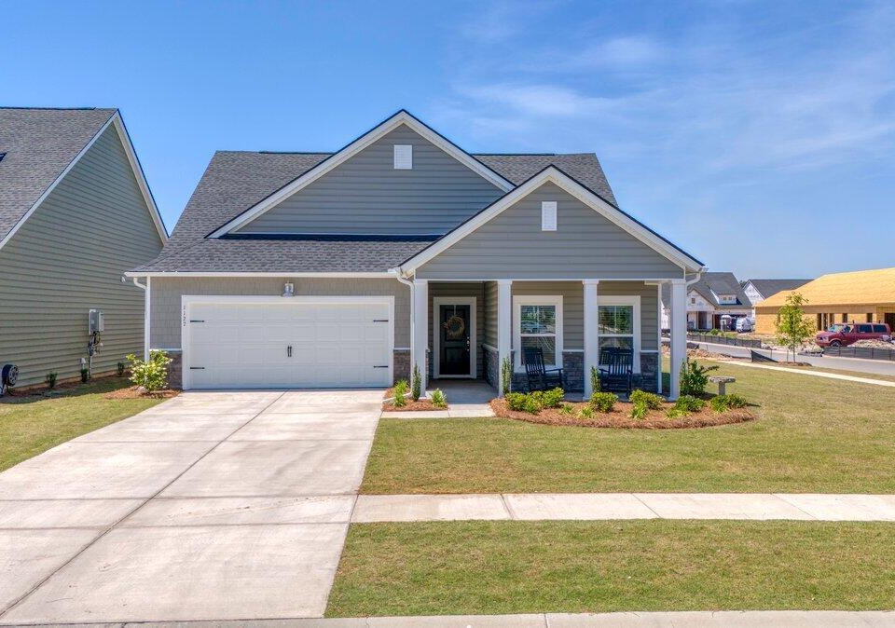


Horizons at Summers Corner Realtor Open House
May 23rd 11:30-1:30
1005 Locals Street
MLS# 24006098
$409,500
Grab-n-Go Lunch available
Beth Mandell
803-463-7734
bmandell@century21properties.com
Century 21 Properties Plus
Drawing for a $100 Gift Card to Halls Chophouse.
Must visit both homes to enter the drawing.
RSVP By Wednesday, May 22nd
1127 Ark Shell Drive
MLS# 24010449
$410,000
Dessert and Prosecco
will be served
Elissa Campbell
843-853-1433
elissa.campbell@agentownedrealty.com
AgentOwned Realty Preferred Group

