Slide 1
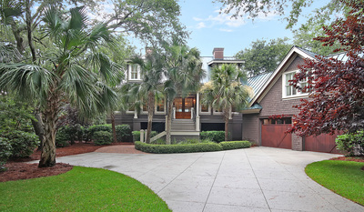
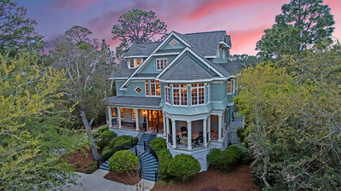
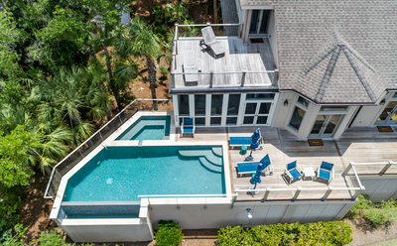
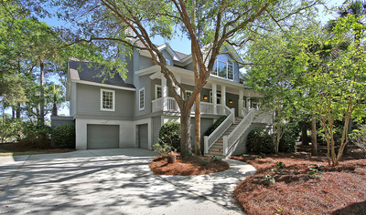
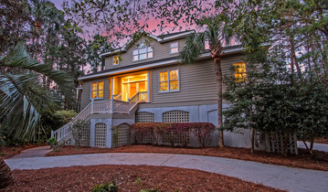

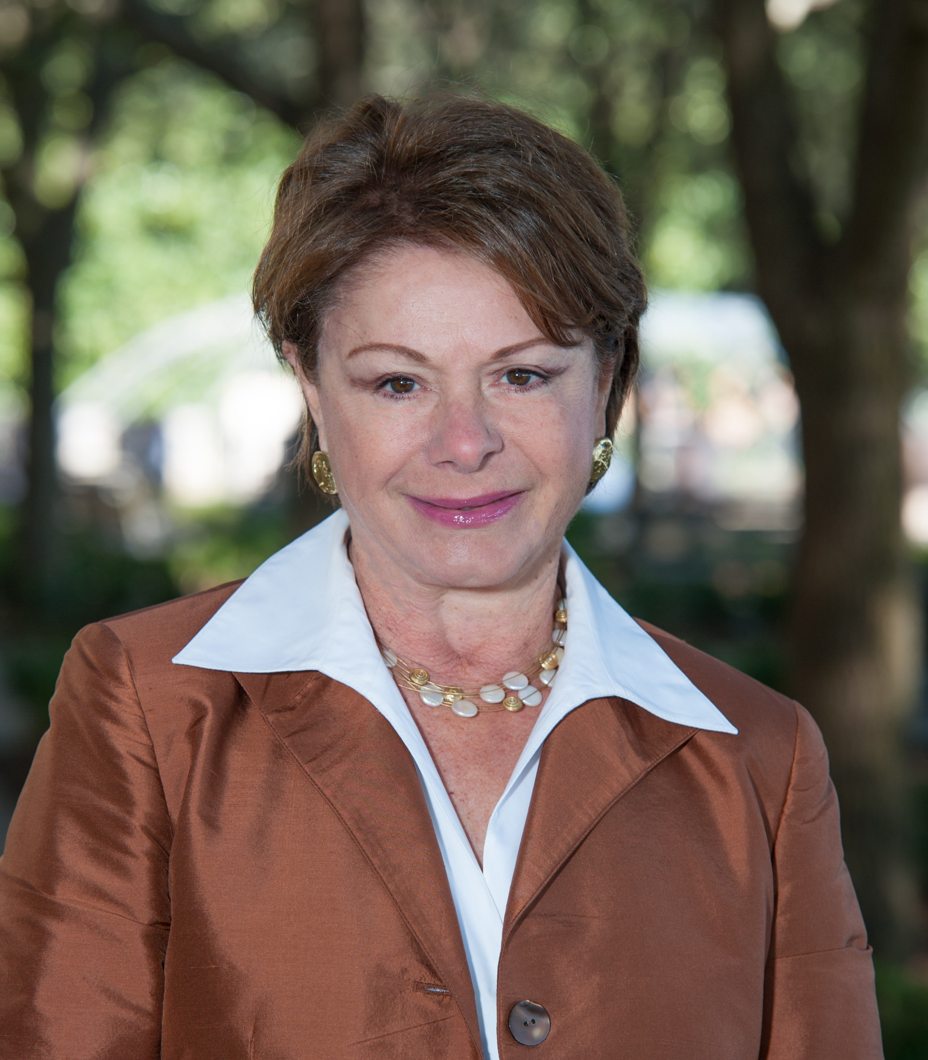
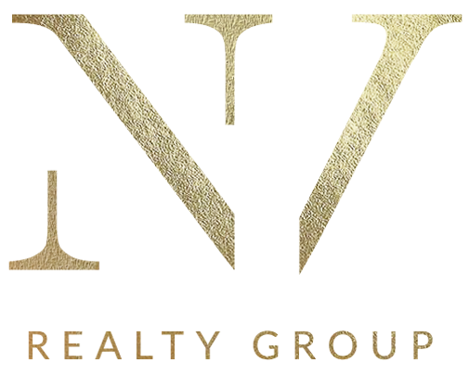
Earn a full buyer's side commission by referring qualified buyers to me.
Hi, my name is Toula DiGiovanni. I am a Broker/Agent marketing luxury Beach/Golf homes in the Private community of Kiawah Island South Carolina. I currently have five (5) homes listed and am reaching out to Agents that may have clients looking to locate to Kiawah.
By referring a qualified client that purchases one of my listings you will receive the full buyer’s side commission. If the client purchases another agents listing thru me I will reimburse you 25% of my commission on the sale.
My Current Listings
(Click on picture for more information)
Great Investment Potential
40 Kiawah Island Club Dr 31 Salt Cedar Lane 128 Spartina Lane
Offered at $2,395,000 Offered at $2,595,000 Offered at $2,195,000
Great Investment Potential
712 Glossy Ibis lane 554 Bufflehead Dr
Offered at $1,175,000 Offered at $1,295,000
Toula DiGiovanni
843.469.7555
toulad@nvrealtygroup.com
toula.nvrealtygroup.com

