Slide 1
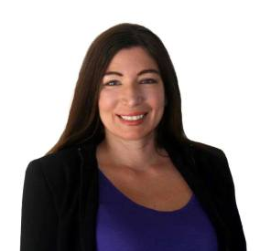
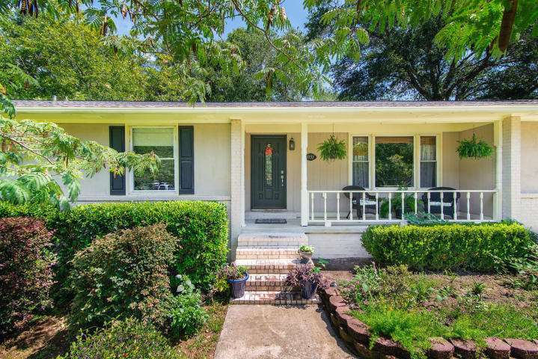
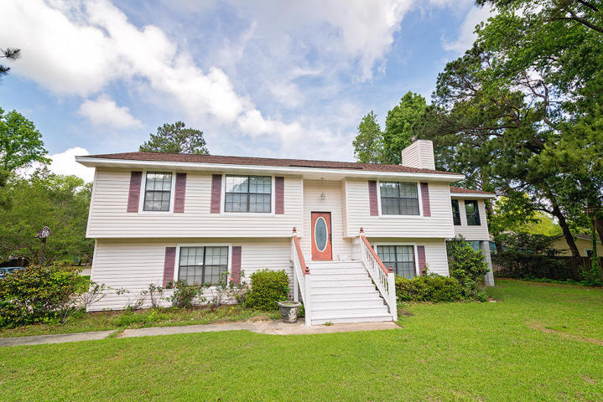
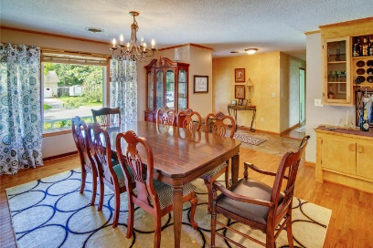
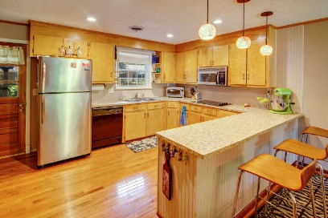
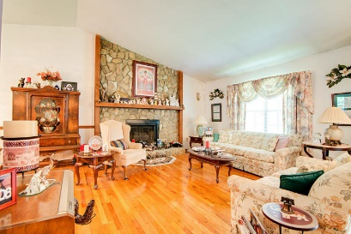
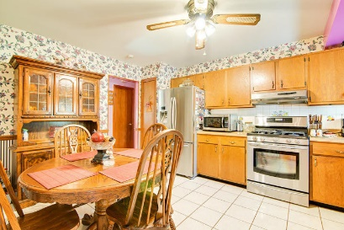
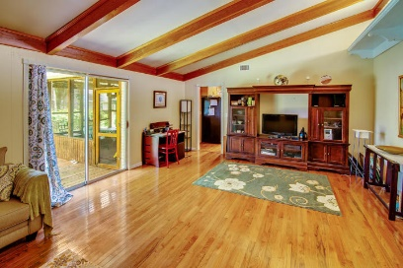
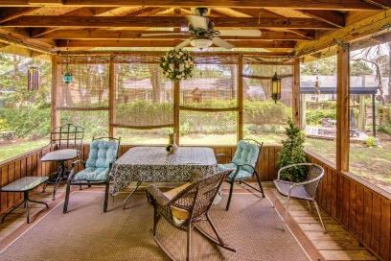
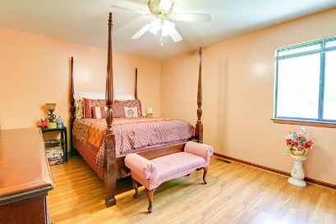
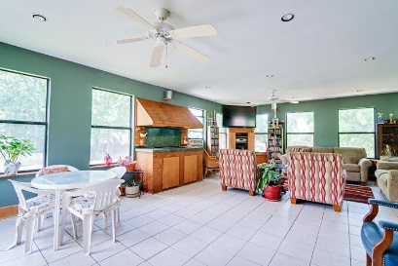
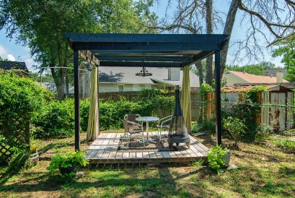
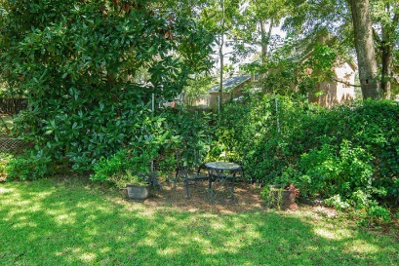
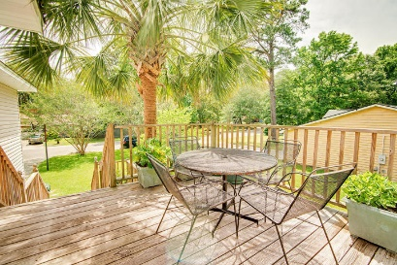
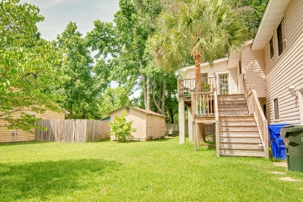
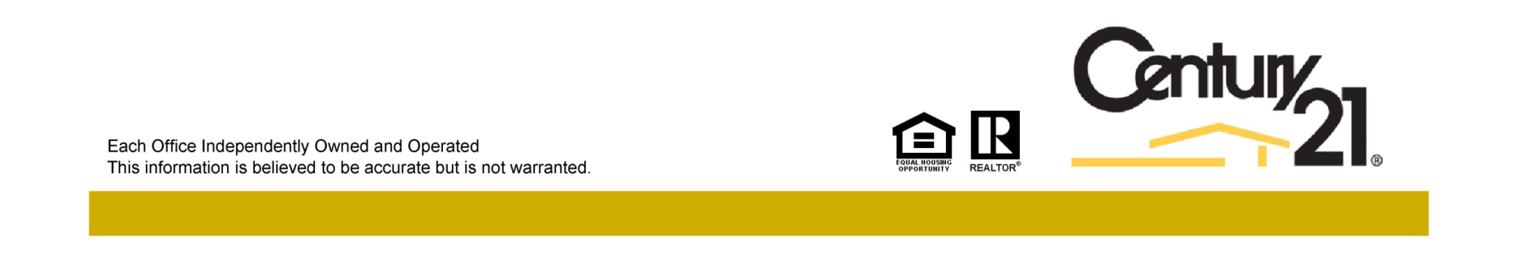
Agent Bonuses Available!
Jacqui Swain
Office (843) 871-1710
Mobile (843) 295-9484
jacquiswainc21@gmail.com
www.JacquiSwain.c21.com
Agent Bonuses Available For Each Property with a ratified contract by 9/30/17 to be paid through closing
$800 Bonus
$500 Bonus
1131 Talisman Road
Rosemead | Mount Pleasant
MLS# 17022977 | $385,400
2330 Assembly Drive
Ashleytowne Landing | Charleston
MLS# 17017037 | $310,000
Century 21 Expert Advisors | 100 Seven Oaks Lane | Summerville, SC 29485-8514

