Slide 1
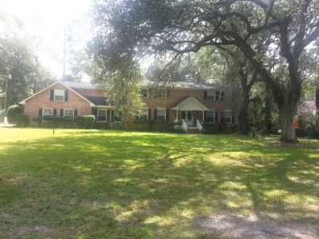
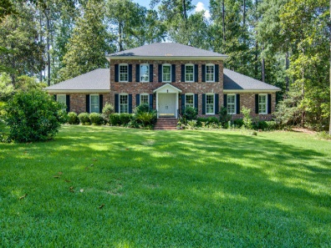
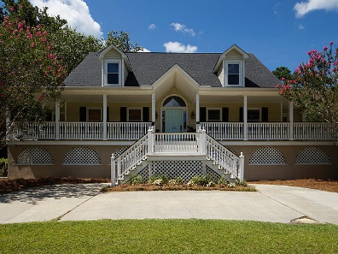
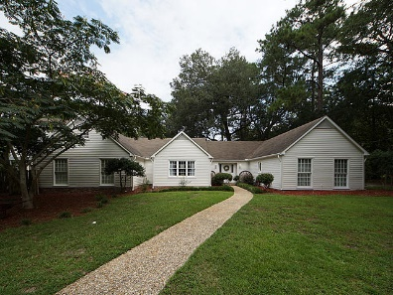
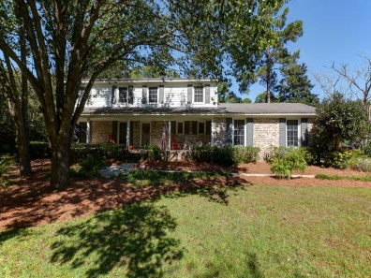
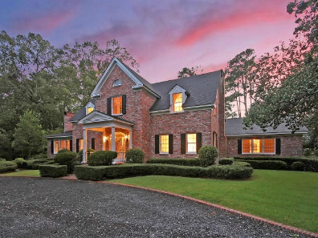
Tea Farm Agent Open Houses
Thursday, October 26th, 11:30a-1:30p
114 W Johnston Street
MLS# 17027287
$569,800
Sherryl Falvey
843-209-0025
s.falvey@BHHSSCRE.com
BHHS Southern Coast
104 W Shepard Lane
MLS# 17016030
$450,000
Lori Claussen
843-224-8506
loric@goldenbearrealty.com
Golden Bear Realty
301 E Shepard Lane
MLS# 17020187
$425,000
Van Waring
843-767-7777
waringrv@gmail.com
RE/MAX Pro Realty
Six Homes Open For Viewing
Visit all six homes for a chance to win one of two $250 GDC gift cards
111 W Walker Drive
MLS# 17021399
$450,000
Suzanne Conway
843-814-6778
s.conway@bhhssun.com
BHHS Carolina Sun Real Estate
117 E Walker Drive
MLS# 17028203
$380,000
Christi Fabie
843-224-9425
christi.fabie@carolinaone.com
Carolina One Real Estate
102 Sebring Street
MLS# 17025580
$674,000
Missy Reid
864-934-5447
missy@mattoneillteam.com
Matt O'Neill Real Estate
** Agents: please plan to show your pocket card at the gate **

