Slide 1
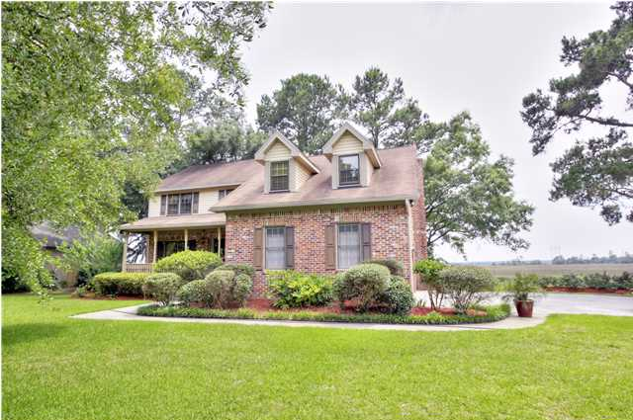
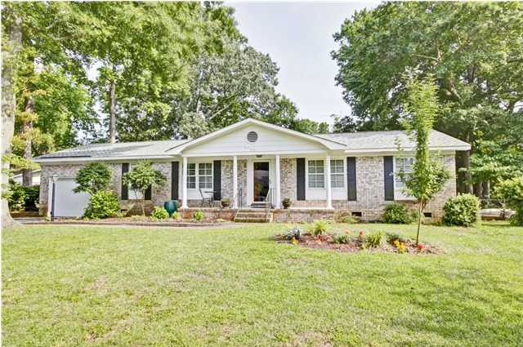
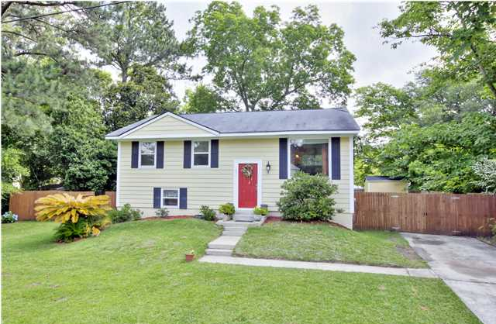
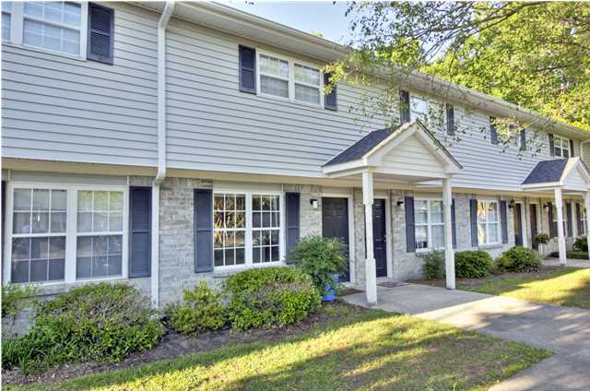
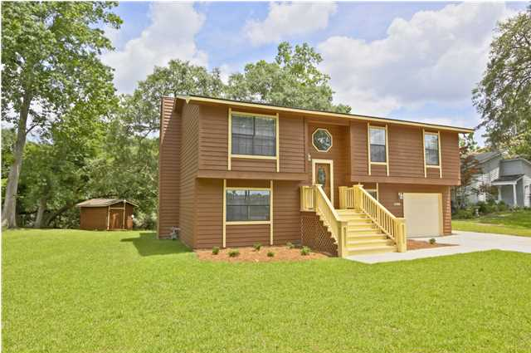
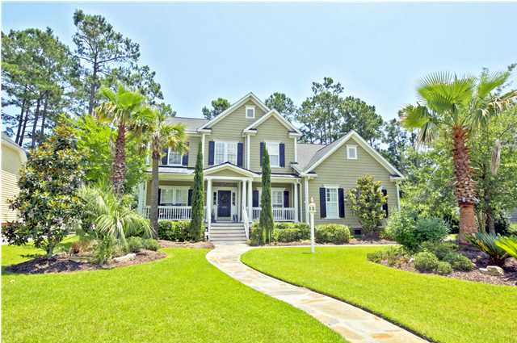
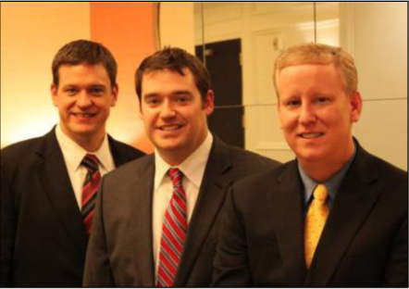

ChuckTown Homes New Listings!!
Sylvan Shores
Charleston
$425,000
MLS# 1414440
Queensborough
Charleston
$235,000
MLS# 1414377
Click here to view listing
24-hour Information Hotline
888-210-3348 x3149
Click here to view listing
24-hour Information Hotline
888-210-3348 x3759
West Ashley Plantation
Charleston
$219,900
MLS# 1414571
Wildwood
Charleston
$79,900
MLS# 1414830
Click here to view listing
24-hour Information Hotline
888-210-3348 x3689
Click here to view listing
24-hour Information Hotline
888-210-3348 x2999
Covington Hills
North Charleston
$200,000
MLS# 1415039
Park West
Mt Pleasant
$650,000
MLS# 1415408
Click here to view listing
24-hour Information Hotline
888-210-3348 x2689
Click here to view listing
24-hour Information Hotline
888-210-3348 x3539
The ChuckTown Homes Team
Owners:
Donald Russell, Jeremy Wilson, Shawn Pillion
Buyers Specialists:
Andrea Parler, Megan Tice, Tammie Phillips, Cayce Hennessee, Polly Cillpam
Phone: 888-210-3348
info@chucktownhomes.com
www.chucktownhomes.com

