Slide 1
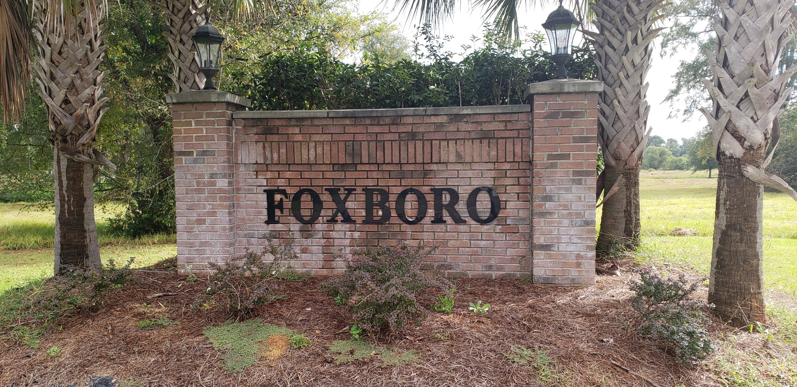
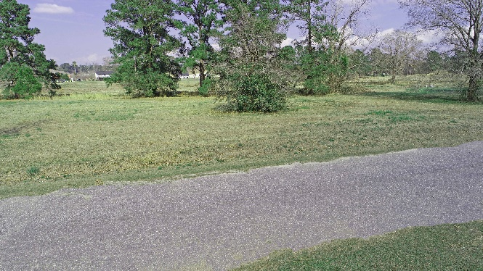
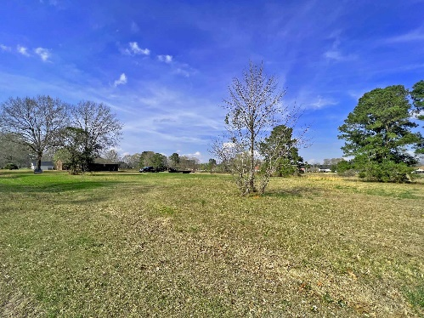
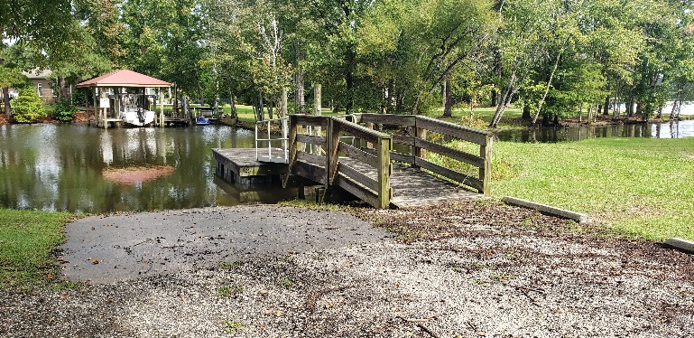

Take Your Pick
Tennis Lane
Summerton, South Carolina
Take your choice from 11 lots…$18,000 per lot
Lake Homes Realty, LLC
Elloree, SC 29047
www.SCLakeLife.com
Kristie Anderson
(803) 387-9459
kristie@sclakelife.com

